Slide 1
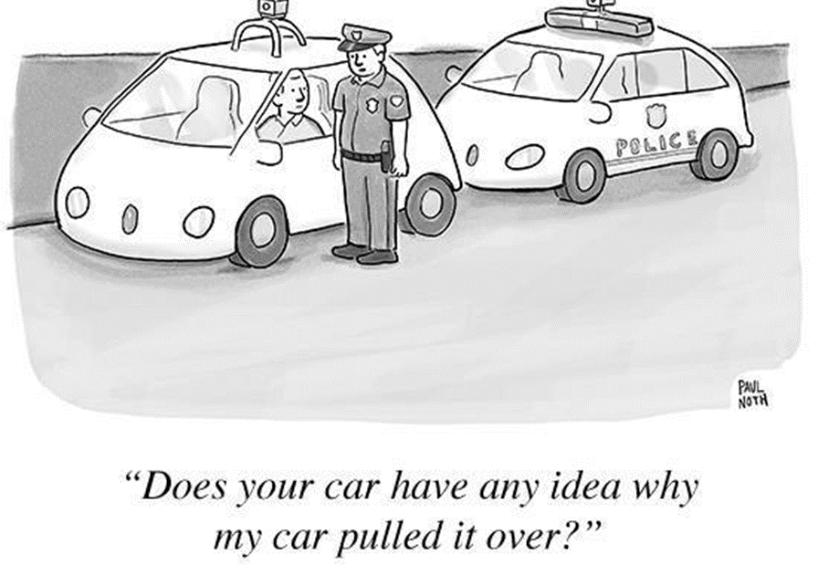
Some reflections on a Just Transition in Auto after Brexit Managing the Impacts of Economic Change, ACU Rome Campus, Rome.
Professor David Bailey
Birmingham Business School
Senior Fellow- UK in a Changing Europe Programme
Professor Alex de Ruyter
Centre for Brexit Studies
Birmingham City University

Slide 2
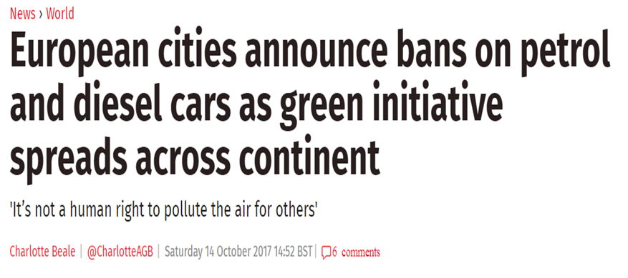
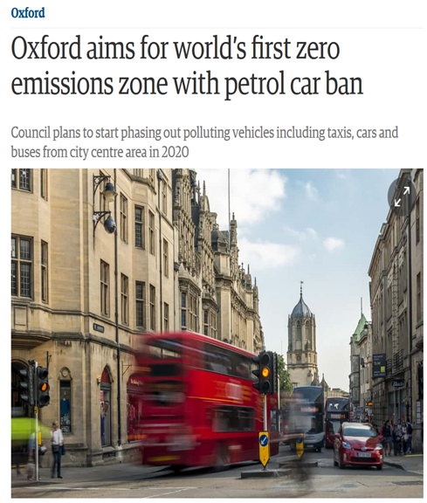
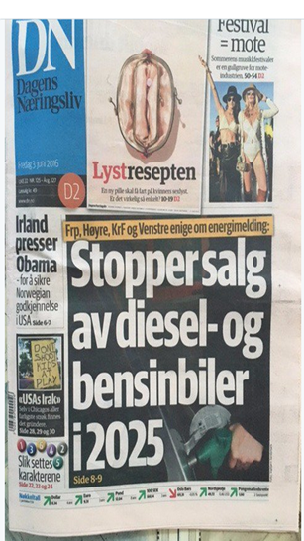
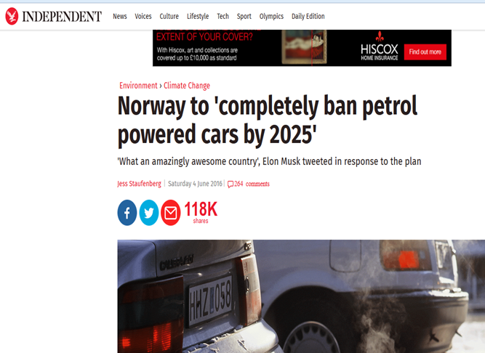
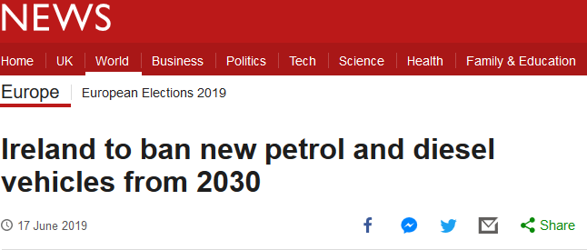
Bans coming on ‘ICE-only’ vehicles

Slide 3
The Covid hit…
The impact of Brexit

Slide 4
What is a “just transition”?
Coming decade will see far-reaching changes on the global automotive industry.
Bans on ICE vehicle sales starting 2030
Shift to fully electric vehicles
Introduction of autonomous and self-driving vehicles
Changes in vehicle use patterns, especially in urban areas
Emden et al. (2021) define a Just Transition as:
“securing the future and livelihoods of workers and their communities in the transition to a low-carbon economy. It is based on social dialogue between workers and their unions, employers, and government, and consultation with communities and civil society” (ibid.).

Slide 5
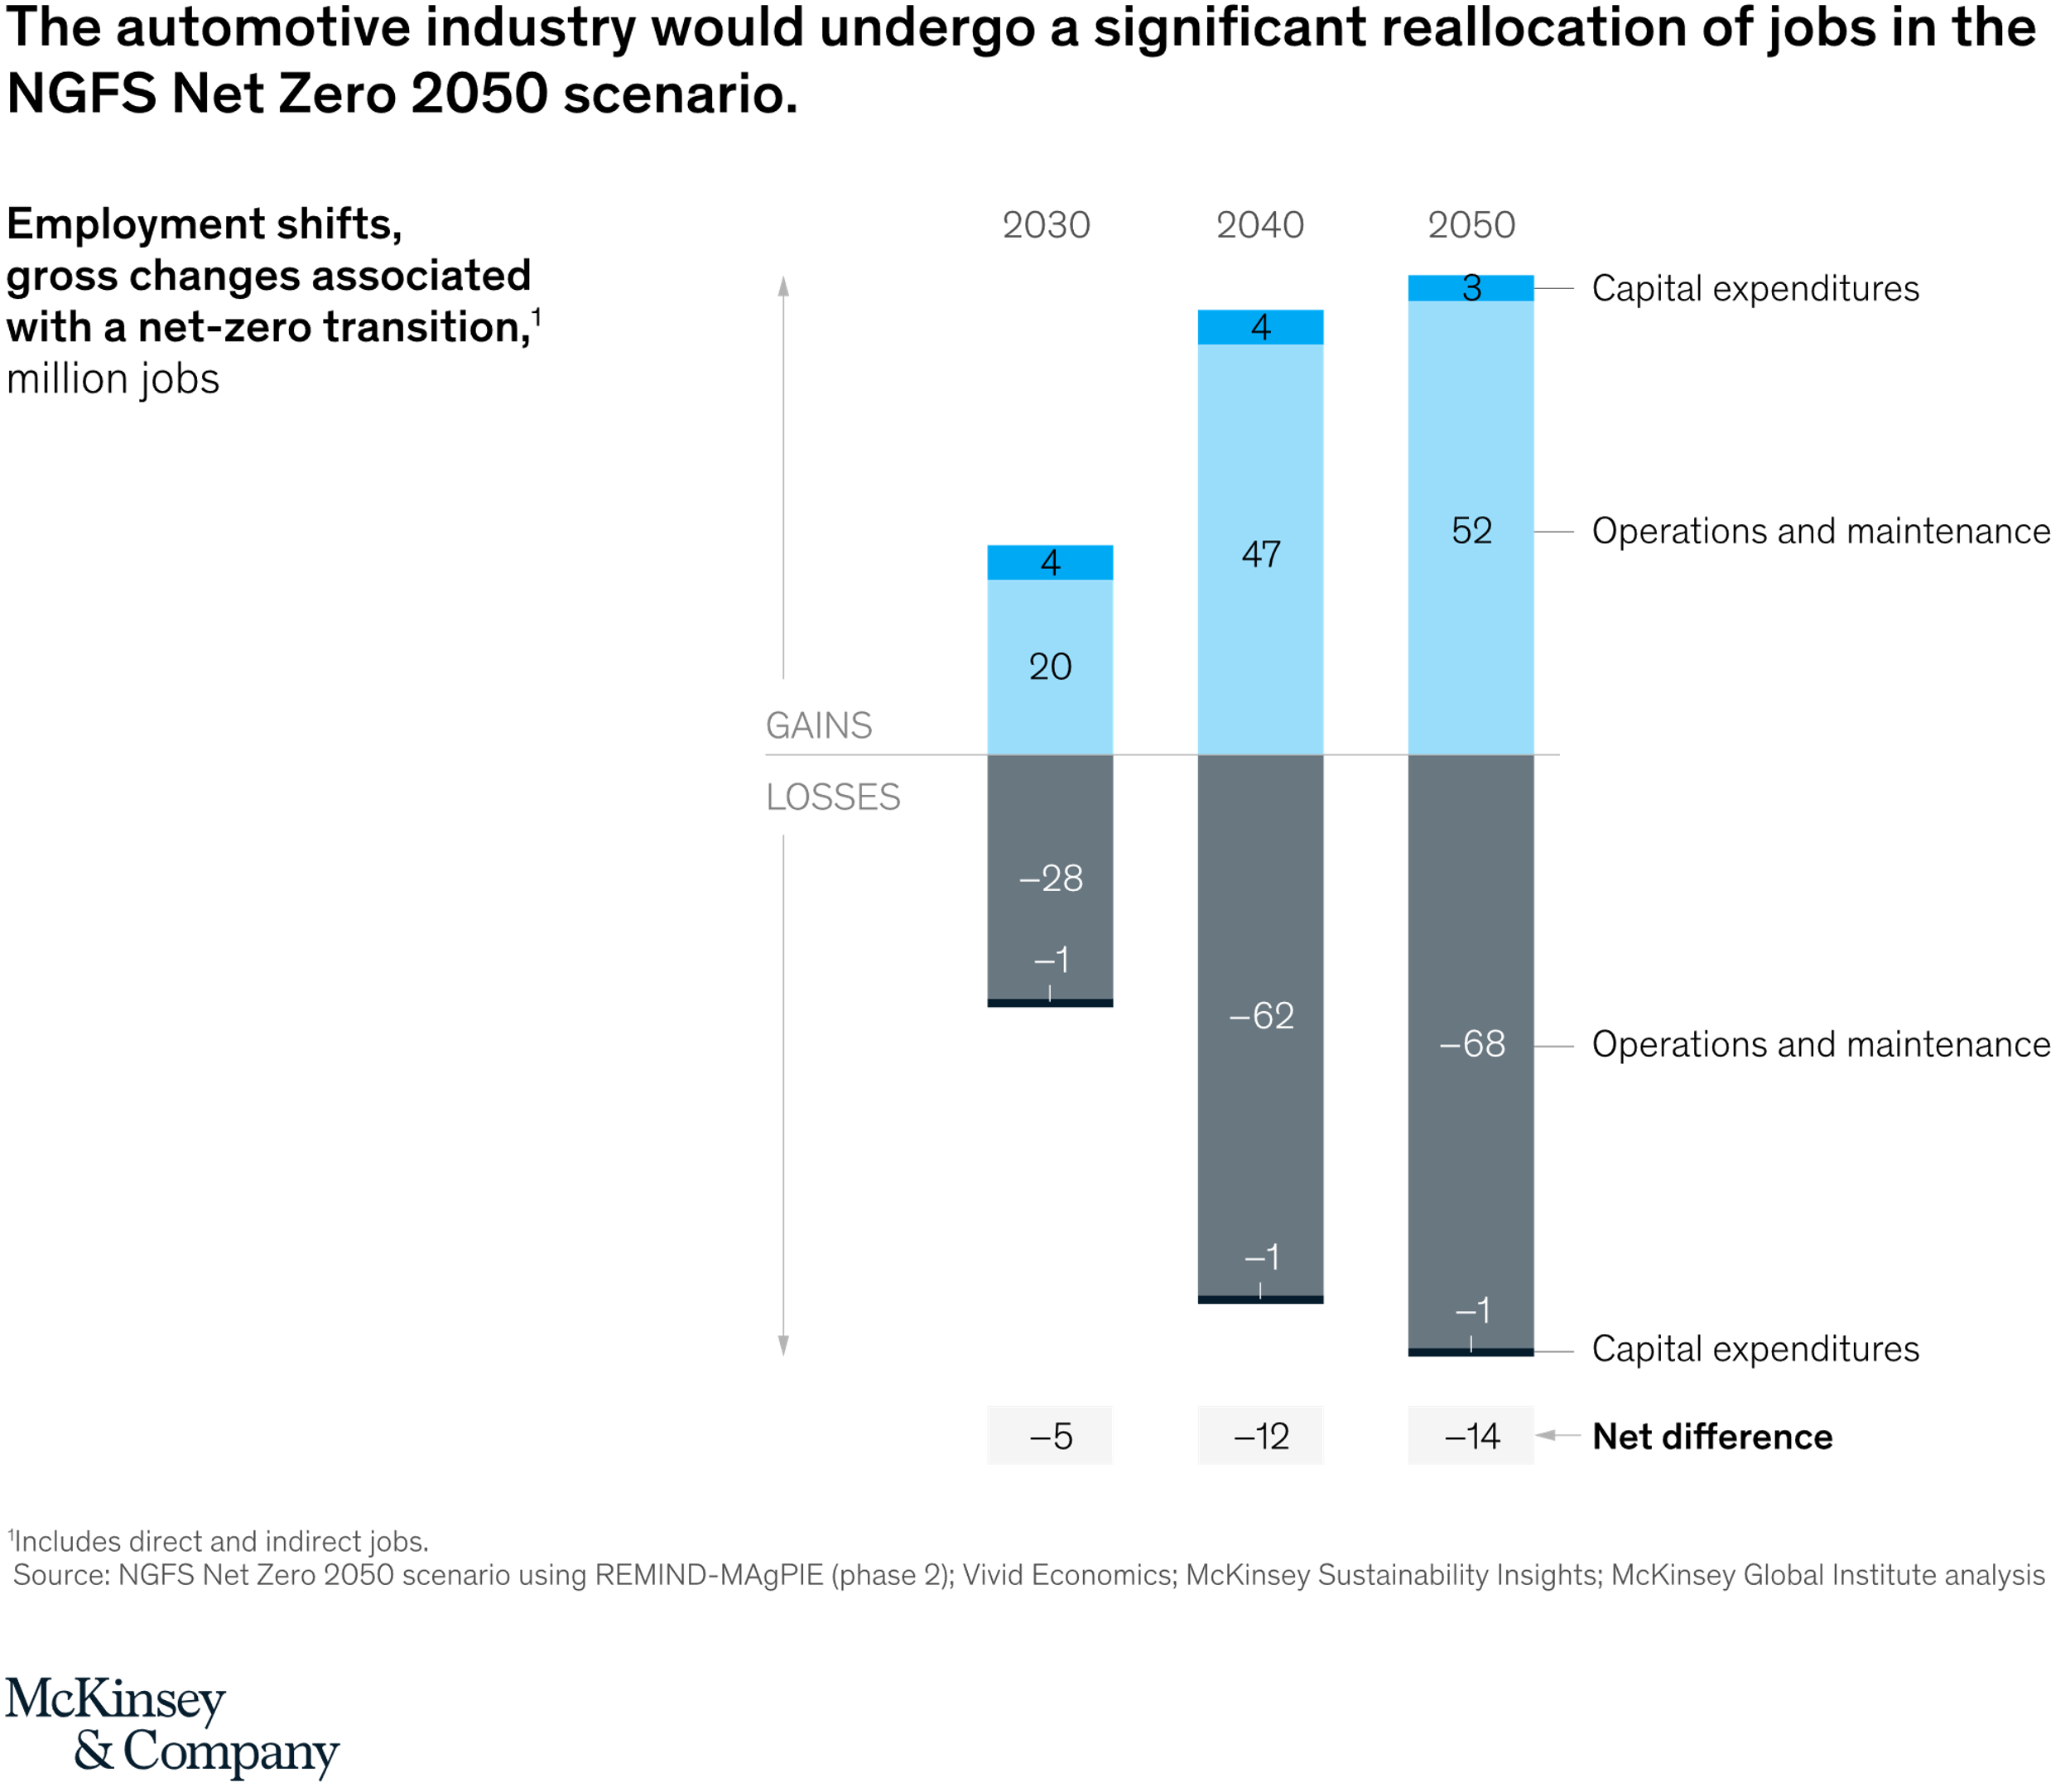
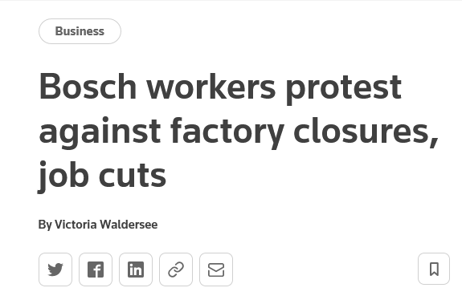

Slide 6
Some quick reflections
Size of the impact?
Models of Capitalism – co-determination?
Make or Buy?
Whole Value Chain?
Policy implications

Slide 10
Scale of impact? German estimates…
National Platform Future of Mobility (NPM) (2020): more than 400,000 jobs in the country’s car industry could be gone by 2030 in a worst-case scenario involving a rapid switch to electric vehicles.
Boston Consulting Group (BCG) (2020): little difference in the number of personnel and amount of work involved in building an electric car and a vehicle with a combustion engine.
Fewer workers are required to build engines, but not the whole car, as e-mobility requires new production stages, such as battery cell and module production and packaging, as well as power electronics and thermal management of the battery.
Vehicle assembly or laying the wires also more labour-intensive for electric cars than for vehicles with combustion engines, according to the study. But… battery cell production an issue?

Slide 11
Fraunhofer Institute for Organization and Industrial Engineering: "job losses from the introduction of electric mobility are likely to be substantially lower in the area of vehicle manufacturing than global studies have predicted."
Expect employment in this area to fall by 12% this decade, due to output volumes and higher productivity. But supplier industry could face significant job losses.
"With respect to component manufacture, however, labour requirements are 70% higher for the production of a conventional powertrain than for the production of a powertrain for an electric vehicle," the study says.
"there is no uniform employment trend in the 'transformation corridor' over the coming decade. Instead, there will be a complex, interconnected mixture of job creation, job upgrading and job cuts." Vital to ensure that SMEs do not fall victim.

Slide 14
Implications for the Value Chain 1
→ ‘fleet-based on-demand personal mobility’ value chain, comprising components which will share data across the value chain, such as:
Vehicle design and manufacturing (existing automaker, outsourced automotive manufacturer, supplier or fleet operator, operating more on an open innovation model).
Operating Platform (existing automaker, tier 1 supplier or new entrant like Waymo, Renovo or Drive.ai)
User Experience Platform provider (controlling the passenger’s mobility experience, including in-cabin experience, including hardware, software and data.

Slide 15
Implications for the Value Chain 2
Data services provider: content - entertainment, traffic, mapping or weather, consumed by ACE platforms or passengers in ACE vehicles.
Fleet creation: fleet operators could specify, design and buy/lease from a specific vehicle manufacturer or lease vehicles from a ‘fleet creation company’, as in the airline industry. Fleet creation involves financing and insurance.
Fleet operator: firms operating and managing the fleet of ACE vehicles offering on-demand mobility services - extend to integrating on-demand with public transport and to ‘Global Distribution System’ firms (as in the airline industry) offering reservations to on-demand mobility services?
Fleet service and maintenance provider: servicing, maintaining and supporting fleets – specialists may provide this service.

Slide 16
Study of the West Midlands (WM) auto industry
Supplier firms in WM :
Are particularly exposed to the operations of Jaguar Land Rover (JLR);
Lack capacity or the specialist equipment needed to undertake production of batteries, high value battery components and key components for electric motors;
Suffer from increasingly uncompetitive energy prices relative to other European countries which will likely impact future investment.

Slide 17
Survey of workers
156 responses obtained earlier this year:
75% from OEM employees (approx. 48% from JLR) and 16% from Tier 1 supplier;
44% had worked in their current job for 6-10 years and 41% for more than 10 years;
97% directly employed by company;
72% had commute of 30 minutes or less;
50% would prefer to work fewer hours;
65% had not heard of the phrase “just transition”.

Slide 18
14. How secure do you feel about your job?
West Midlands Automotive: Unite Survey

Slide 19
15. How confident are you that your workplace will survive and manage the transition to low emission vehicles?
West Midlands Automotive: Unite Survey
The changing automotive industry

Slide 20
17. How much do you think your current skills overlap with the skills needed for making low-carbon vehicles? (Electric, Hybrid or Hydrogen.)
West Midlands Automotive: Unite Survey

Slide 21
19. Do you expect to be working in the automotive industry in 2030? (The year the petrol and diesel vehicle ban will begin.)
West Midlands Automotive: Unite Survey

Slide 22
JOBS, SKILLS AND TRAINING
M/M to E/E
Automation & digitisation
Job loss in ICE/Job growth in EV

Slide 23
Impact of electrification and digitisation on occupations/job types
Job impact in production and technical development departments | Pessimistic Assumption | Optimistic Assumption
Production Operatives | -30% | -10%
Supply chain coordinator | -10% | 0%
Production coordinator | -10% | 0%
Machinery supervisor | -5% | 0%
Project Managers | -4% | 0%
Production Planner | -3% | 0%
Developer | 0% | 5%
Electrotechnical worker | 0% | 10%
Software developer | 5% | 30%
Data Analyst | 250% | 350%
Herrman et al. (2020, p. 93ff.)

Slide 24
Skills Requirements
The production of electric vehicles requires:
Knowledge of electrics, electronics, and IT; skills in the handling of high voltage systems… for the installation of interior components and the laying of cable harnesses.
High voltage awareness, ability to work with high-voltage components; handling chemicals & hazardous materials.
Skills in the operation and servicing of machines for the production of electrodes.
Quality management of electrochemical energy storage.
knowledge of networking, data management, and process planning….

Slide 25
Skills Requirements and Qualifications
Development of a Digital Production Platform requires:
Skills in data analysis and development of software
Engineers with software and digital skills
Ability to think and act in an interdisciplinary manner
First degree and higher level of education
Degree in Advanced Manufacturing Engineering
NB Also impacts ‘back office’ functions
There are ‘unknown’ skills

Slide 26
Activities, level of qualification by job type, in a typical gigafactory
Job Type & % | Employment Activity Profile | Level of Qualification
Production Operators 60% | Material handling, machine loading, machine unloading, pack assembly, logistics, module/pack assembly, inspection | Level 1-3
Equipment Technicians 15% | Machine Service & maintenance, optimising machine performance, quality control, reviewing cost & delivery | Level 3-5
Engineers & Senior Staff 10% | Facility Engineers, process/production engineers, IT and data management, achievement of KPIs, legislation checks | Level 6 & up
Quality Technicians 5% | In-process controls, confirmation of specifications (parts and supply), performance evaluation, assessment of defects | Level 4
Quality Engineers 5% | In process controls, confirmation of part/supply specification, performance evaluation, defect analysis | Level 6
Management & HQ functions 5% | HR, Finance, purchasing, IT and data management | Level 6 & up
Faraday Institution (2020)

Slide 27
Is the WM region ready on skills and training?
Unite survey results:
12% had a Bachelor’s degree; 4% a Postgraduate degree
85% said their employer hadn’t offered training
90% said they hadn’t undertaken any training of their own volition
69% said they would consider retraining for a new role
NB. Training programmes being undertaken by Nissan, Toyota, BMW and VW but is enough being done?

Slide 28
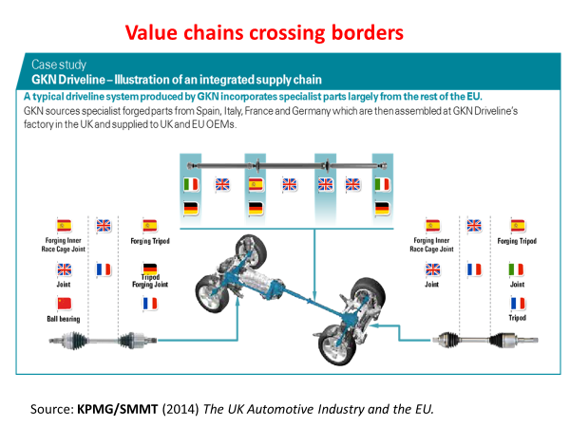
WHAT ABOUT WORKERS MADE REDUNDANT?
Metal working activities, especially stamping and cutting (turning, milling, drilling, grinding) declining
Firms closing already (eg GKN Driveline)
VW plan for a ‘just transition’
Create jobs in other business activities and re-train workers to do the jobs in new business areas
Guide employees through the transition & give help to gain qualifications to enhance employability
Generous redundancy package
Our plan for a ‘just transition’?

Slide 29
28. No 1 Policy Priority
West Midlands Automotive: Unite Survey

Slide 30
Policy?
‘Coordination failure’ – role for industrial policy
Collaborative approach / participation / knowledge discovery – modern industrial policy
Training/retraining/skills throughout life (Singapore, Scandinavia, Germany)
Worker participation
Diversification / reorientation (supported by who?) MG Rover experience
Reshoring (supported by who?) MAS / AMSCI experience
Financing investment – eg battery gigafactories
Building a new value chain (supply chain is vulnerable given shift to in-house): raises an issue for Smart Specialisation
Multiple transitions
Welfare systems?
Value capture as well as creation
UK: Brexit?

Slide 31
Research underpinning this presentation (All available for free, open access)…

Slide 32
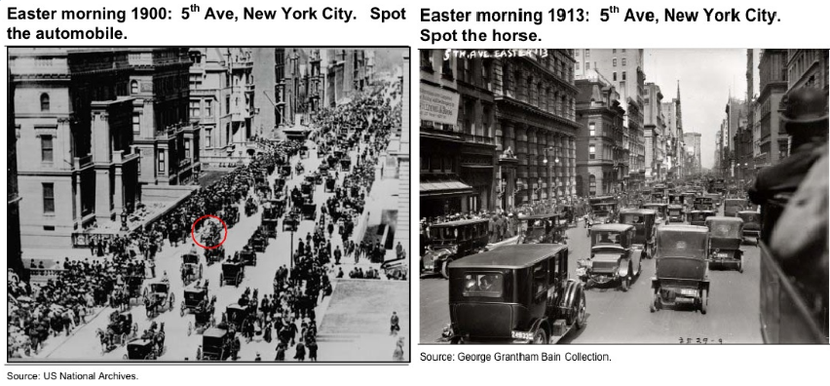
We’ve been here before…

Slide 33
Challenges & Opportunities
Skyfall
Q: It always makes me feel a little melancholy. Grand old war ship, being ignominiously hauled away to scrap... The inevitability of time, don't you think? What do you see?
Bond: A bloody big ship.

Slide 34
Contemporary Social Science Special Issue Enabling a Just Transition
On the multi-dimensional and multi-scalar nature of a Just Transition.
We encourage the submissions of original articles, both theoretical and empirical, that investigate and analyse from single disciplinary and multi-disciplinary perspectives the following, not exhaustive, topics:
Implications for workers, trade unions and employment relations;
Organisational governance and regulatory change
Global Value Chains (GVCs);
Industrial and sectoral scenarios;
Implications for industrial policy;
Territorial challenges for devolved nations and regions;
Environmental policy and management;
The impact on the lived experience of marginalised communities;
Social policy and welfare reform, and;
Cultural dimensions.

Slide 35
Contemporary Social Science Special Issue Enabling a Just Transition
Guest Editors Alex de Ruyter (Birmingham City University) and Gill Bentley (Birmingham City University) welcome submissions now.
For full instructions on submitting to the journal please see the Instructions for Authors page.
All papers will be peer reviewed.
The closing date for submitting papers is 31st March 2023 (sooner the better…)
Manuscripts should follow the journal instructions for online submission of papers.
For any queries contact:
alex.deRuyter@bcu.ac.uk bentleygill@aol.com

Slide 36
Thanks for listening.
Comments, Questions welcome.
@dgbailey
d.g.bailey@bham.ac.uk

