Slide 1
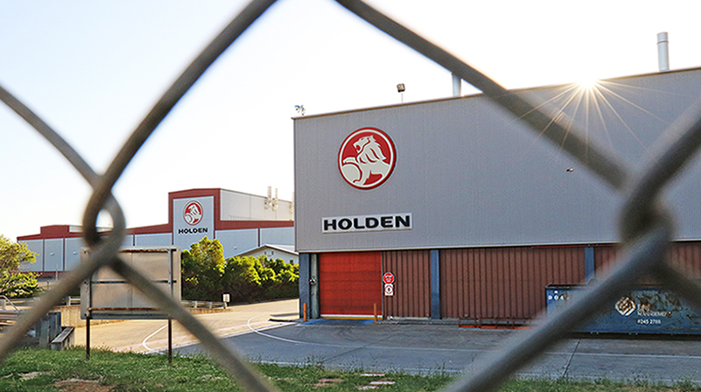
Agency without intention? Exploring the agency of ex auto workers and their decisions
Presentation to a workshop
Vatican City,
14 November 2022
Professor Andrew Beer
Executive Dean, UniSA Business

Slide 2
Agency
Agency is conceptualised as a purposeful intervention in the fortunes of a region, as those with the capacity to act identify their ‘room to manoeuvre’ (Hutchinson & Eversole 2022) and seek to reshape their economic future
Grillitsch et al (2022 p 9) have argued that
similar (industry) configurations may lead to different outcomes (multifinality). From a critical realist perspective, this is not per se problematic because causal powers such as the three types of change agency do not produce an outcome in a deterministic nor probabilistic manner but that exercising such powers by local actors makes that outcome possible.

Slide 3
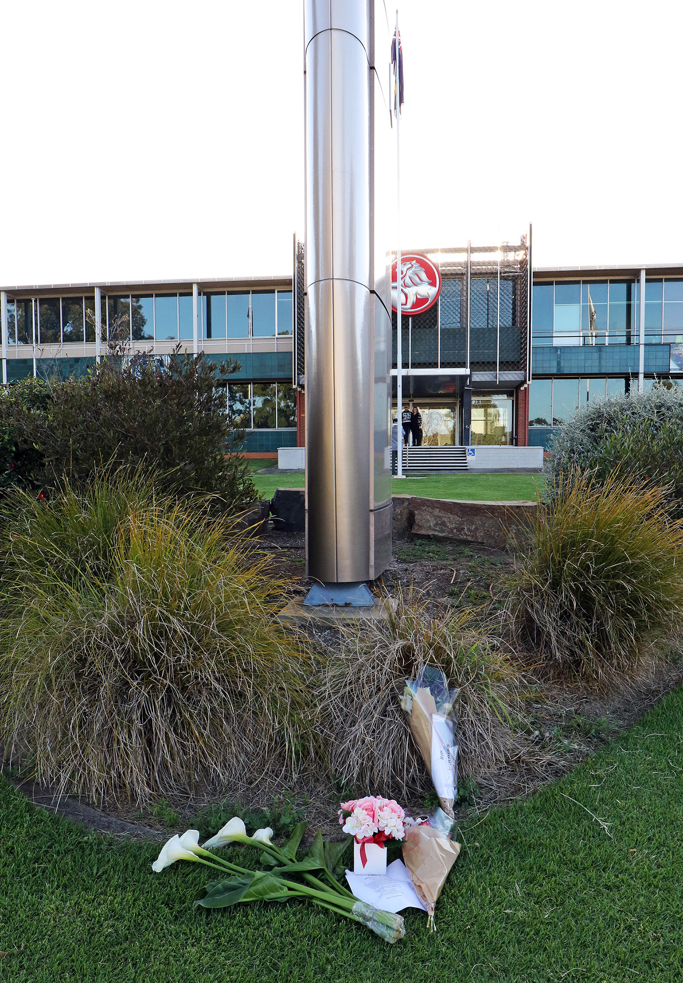
Agency
Agency affects both the direction and speed of economic change in regions (Grillitsch et al 2022 p 2).
In sum, the literature implies a high degree of intentionality; that actors are relatively powerful and overtly aware of their influence; and, finally, that they are deliberate in their behaviours and decision making – taking purposeful steps to bring about change.
PHOTOS: SANDY HORNE

Slide 4
Alternative viewpoints
… much of social life is a result of the unintended consequences of the cumulative actions of large numbers of past and present actors … Individuals may be unaware of all the causes of their behaviour, and intentions may form only a portion of the explanation of action. However, we suggest that macroscale social structures should be precisely defined, that they do not have autonomy or an existence that is not ultimately reducible to cumulative human actions and interactions, and that the processes linking structure or context and individual or social action need to be carefully specified (Duncan & Ley 1982 p 32).

Slide 5
Closure of the Australian car industry
Comprehensive actions by both the OEMs and state and national government
Little local government engagement, and virtually no community engagement
Framed in the context of Australia’s workfare state
Strong focus on workers finding work as quickly as possible
The highly skilled, high status workers added to their skill sets; the low skilled, low status workers did not
Undertook training at a lower skill level – eg forklift driver

Slide 6
A discrete choice experiment

Slide 7
DCE outcomes
Workers valued employment that offered a degree of autonomy and on average respondents were approximately 1.5 times more likely to work for an employer that offers some autonomy than one that offers none.
Respondents were willing to be paid $5 less per hour to work for an employer offering a degree of autonomy.
There was a very strong preference for work in enterprises with a reputation for good work policies and practices. Survey respondents were 1.4 times more likely to work for an employer with medium to high reputation for good work practices than one with a poor reputation.
Workers were willing to be paid $4.5 to $5 less per hour by an employer with a medium to high reputation for the quality of their workplace when compared with one with a low reputation.

Slide 8
DCE outcomes
Commuting time was the third critical factor influencing employment decisions. The average respondent to the DCE was willing to be paid $0.22 less per hour to shorten their one-way commuting time by one minute.
Workers had a strong preference for additional working hours even if the rate paid per hour was lower. The average survey participant preferred a full-time role that paid $10 per hour less than a part time job with approximately ten hours of work per week, but a higher rate of pay.
There was a slight preference amongst respondents for permanent work contracts over casual or fixed term employment, but the preference was not as strong as might be expected amongst a cohort with high job security in their previous auto industry roles. However, as expected, the wage rate was important in shaping the decisions of workers.

Slide 9
Qualitative perspectives
The common things that interviewees described as being outside of their control or having no choice were structural changes.
“I've got made redundant this week … So I went into back into food manufacturing, and I'm not sure if you you've heard the news with Freedom Foods. So we basically got bought out, Arnott’s bought us out. There was just restructuring and things like that.”
They were also most likely to describe procedural and institutional requirements as things they ‘have’ to do.
“Well, I mean, like I, you know, because I applied for Centrelink?... So then I had to become, you know, I had to be registered with a job provider.”
This including the informal ‘game’ of getting shifts, or better shifts, or permanency through casual positions or labour hire:
“Well, what do you do? I can't say no, because people say no, they won't give me the hours, you know what I mean? So you got to play the game. So I will do it. No problem.”

Slide 10
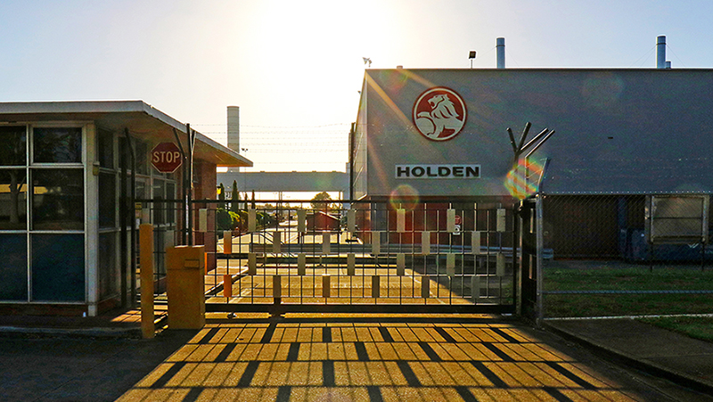
Qualitative perspectives – training
Others felt they had either lacked guidance about how to utilise the training, or made a bad decision.
“I didn’t know what I wanted to do. I didn’t know what I was doing …. What I would say yes to more to is I’d needed more guidance. Maybe. And I’d been in one place all my life. Real world’s different when you work in the same place since you’re 15.”
“I’m spewing I didn’t do something along the carers’ role. I was a bit uneducated … But as time sort of went on, and I’ve become more disenchanted with my management position at the steel place, I’m thinking … That’s kind of cool … So I’m sort of regretting not having a closer look, at those caring type roles. And now, obviously, to do a course I have to pay for it myself.”

Slide 11
Qualitative perspectives – sense of self-determination
Interviewees were unlikely to use language that indicated they considered they lacked agency. On the contrary, they sometimes expressed quite a strident sense of their own self-determination:
“I hated it, that’s why I walked out.”
“to do programs, you had to do courses and things like that, but you weren’t guaranteed a job at the end of it. So I refused to do all that and just find myself a job. There’s plenty of jobs out there if people want them.”
“they put stuff forward you know, they said do you want to do a manager’s job again or a supervisor? I said no. Team Leader job role? No. Then they said how about looking after old people, and I said definitely not. Because I just basically said, look, don’t even worry about me. I was confident that I would find a job.”
“I can’t even remember the name of the company. They were in Tullamarine. And I was successful, but I went there, and I didn’t really get a good feel. So yeah, I went to the interview, and I was successful. And then I said to the agency, I’ve changed my mind.”
“I was just more looking for something closer to home. That was my main focus. I was sick of driving 40 minutes, an hour home every day. Because I could finish out at Elizabeth working with them. And then yeah, hour and a half, maybe two hours to get home, this ain’t worth it.”

Slide 12
Qualitative perspectives – sense of self-determination
“When you’re just out of study, you can’t have any experience. And if they wanted a graduate, the graduate would be like straight out of uni. So they would want like a 20 to 23 year old and the pay would be really minimal, like really small. And because I’ve got a mortgage and I’ve got bills, it’s just not possible … It was sad, when I came to the realization, it was quite bad that I had to make a choice.”
“I’m still thinking about going out on my own actually. I’m in my current position now and like I said, I’m pretty independent. So I’m moving, invoicing and quoting and all that sort of thing, which I didn’t have experience in beforehand. So I’ve got a bit more idea of what's going on now.”

Slide 13
Conclusions
Workers seek a sense of control – or agency – as they navigate the world of job search and reemployment.
Workers are willing to take a lower paid position in order to have greater control and they seek employers with good reputations who may offer that greater sense of autonomy.
Workers believe in their ability to determine their own employment future, even if that can only find expression by rejecting a job offer or choosing to not take on reskilling.
Workers did not consider the cumulative impact of their decision making, which in aggregate has made the path to a fundamental transformation of these economies more challenging.
From the perspective of a positive regional transformation, former auto employees made sub-optimal decisions, behaving as satisficers rather than maximisers, and did so because of the institutional context within which decisions were made.
In short, these workers became actors giving life to a form of agency, but did so without any intention of bringing about change.

