Slide 1
ACU Rome 2022 |
Managing the impact of economic change
Nested Innovation policies for regional transitions
Lisa De Propris, Professor of Regional Economic Development
Marco Bellandi, Universita’ di FIrenze

Slide 2
Contents
4.0 technologies
Top-down
Vs
Bottom up &
middle- and-out
Approaches to technological change
Nested innovation systems & policies
S3 and S4

Slide 3
Fourth Industrial Revolution
Machine learning, mobile tech, 3D, AI, robotics, sensoring & space tech, drones,
as well as
Bio-genetics, biotech, nanotech, neurotech, green & renewables
Notes:
Cyber-physical systems
Increased velocity through the Research-Development-Innovation pipeline
What are the other 3 before?
A first wave of technological change in contemporary history starts with innovations related to steam power, cotton, steel, and railways, coupled with mechanisation and the surge of the factory system. This marked the ‘first’ industrial revolution between the last decades of the XVIII century and the first half of the XIX century. Cottage industries were dwarfed or replaced. Industrial districts (Marshall, 1923) were often seedbeds of those developments, even if progressively challenged by the increasing importance of economies of scale in bigger factories leading to the industrialisation of rural spaces and the emergence of industrial cities and regions.
The second industrial revolution was triggered by the introduction of electricity, heavy and mechanical engineering and synthetic chemistry in the second half of the XIX century. This took in a few decades to the age of oil and automobile. New sectors emerged, not only those related to the automotive systems, and others were given a different identity as in the case of many consumable goods with the consolidation of the large scale production model. Standardised demand was satisfied by mass production thanks to internal economies of scale. Even more complex business forms, such as multi-national firms, developed.
The third industrial revolution was prompted by innovations in electronics and computers, petrochemicals and aerospace, together with demand becoming more and more volatile in many sectors in the last decades of the XX century. Mass markets broke up and more flexible organisational forms such as firm clusters and industrial districts became pivotal points for development, thanks to their flexibility and innovation. At the same time, new technologies enabled faster communications and transport that pushed and accelerated a process of globalisation in production, commerce and socio-cultural integration.

Slide 4
Two narrative
FUTURE
Climate change
Technological change

Slide 5
Socio-economic disruption
transition
De Propris and Bailey, 2020
Notes:
Cyber-physical systems
Increased velocity through the Research-Development-Innovation pipeline

Slide 6
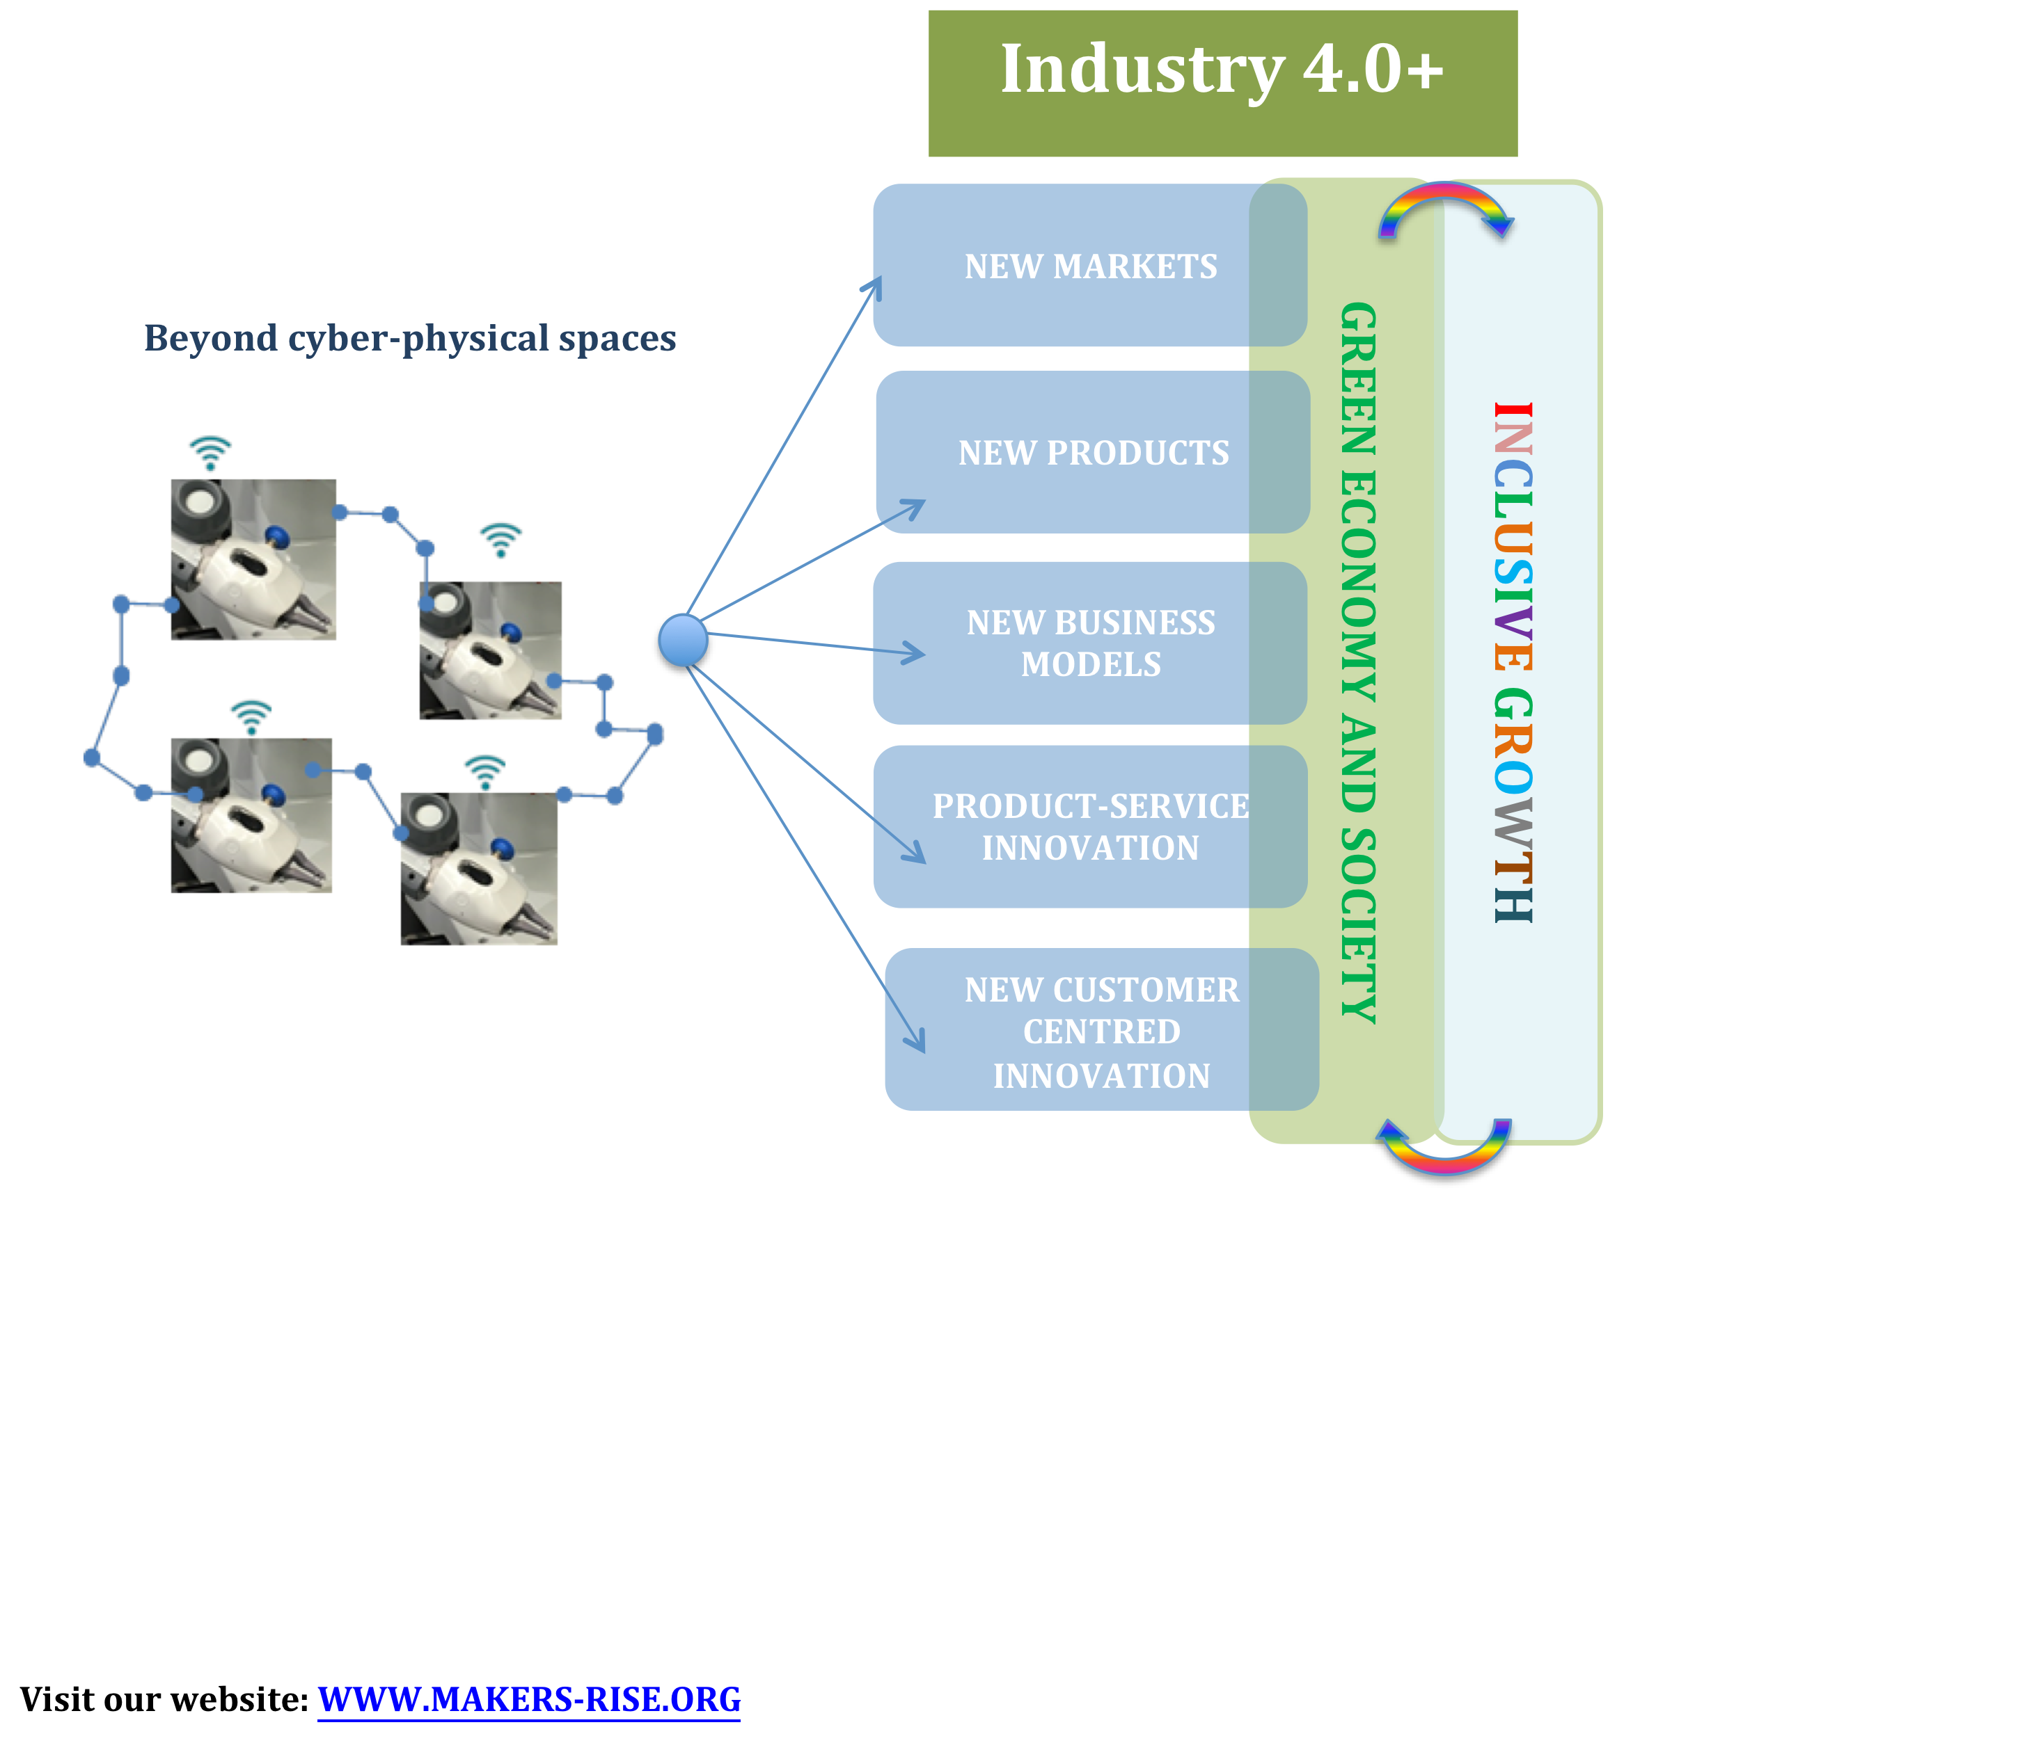
INDUSTRY 4.0+ A Shift in the techno-socio-economic paradigm able to create a green economy and deliver fair growth.
De Propris and Bailey, 2020
MAKERS - Smart Manufacturing for EU growth and prosperity is a project funded by the Horizon 2020-MSCA- RISE - Grant agreement number 691192.

Slide 7
Transitions: green and digital

Slide 8
Twin Transition: green and digital

Slide 9
Twin transitions
This is the opportunity presented by green and digital transitions combined, Twin transitions.
Forms
digitalised green transitions | the (primary) new technology is from the environmental realm and its transformative power is augmented by the combination of (secondary) digital technologies.
sustainable digital transitions | those whose transformative benefits are augmented when (primary) digital technologies are adopted to pursue environmental objectives.
Notes:
Reshapes current debate, which separates out technological change in its effect on digital transitions in the form of automation/AI, digitally-enabled technologies, space technologies, with green transition in the form of decarbonisation.

Slide 10
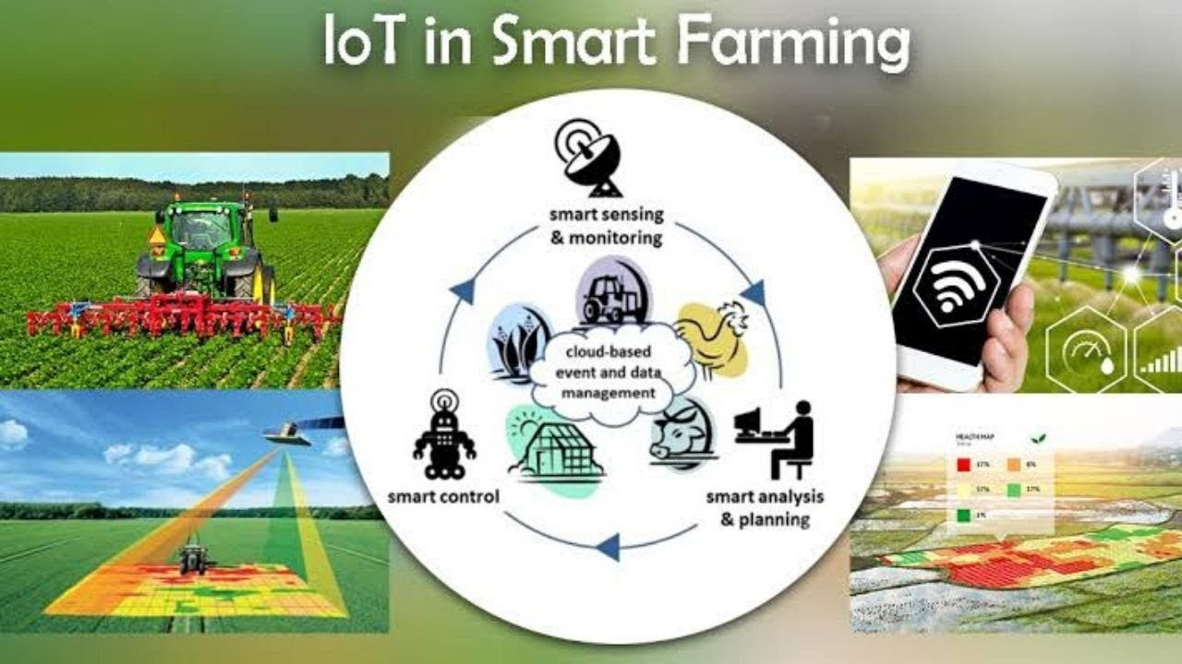
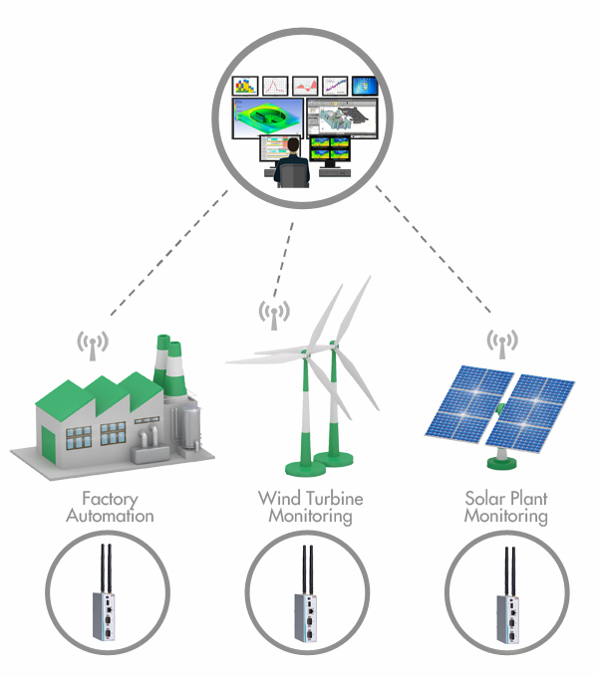
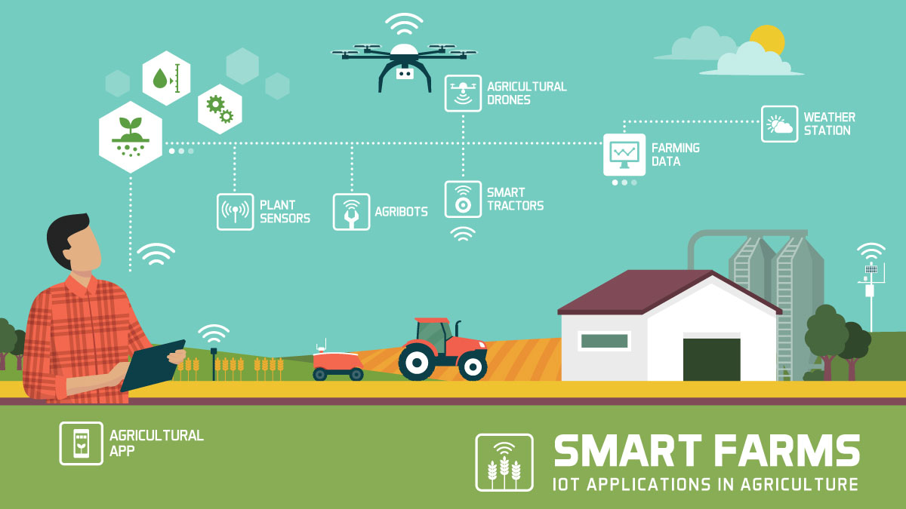
Examples

Slide 11
New problems
These technological changes do not occur randomly but cyclically and in waves
→ opportunities for productivity gains are linked to finding new solutions to new problems.
Identifying what these new problems are becomes therefore crucial to drive and steer the technological transition.
→Innovation–led growth

Slide 12
What drives technological change?
Debate is on the balance between
Science push innovation v. demand pull innovation
System change
Notes:
They overall shifted the conversation from a bipolarism between advanced and developing economies, towards fundamental needs that had to be met by all countries equally, to varying degrees, present in all countries. The rationale here was an understanding but not acceptance that since the 1980s, income and opportunities had become more and more unequal both in developed and in developing economies due to the asymmetric effect of globalisation, global trade and global production.

Slide 13
Technological cycle
Fourth Industrial Revolution (4.0) technologies replaces 3.0 technologies (ICT, fossil fuel technology, human-controlled automation), redefining existing industries and creating new ones, leading to productivity growth, and a green and fair growth.
These technological changes do not occur randomly but cyclically and in waves
[ literature on technological paradigms; Schumpeter, Kondratiev, Perez, Friedman, Dosi; technological regimes such as Nelson and Winter; strategic niche management Kemp et al 1998]
→ opportunities for productivity gains are linked to finding new solutions to new problems.
Identifying what these new problems are becomes therefore crucial to drive and steer the technological transition.
→Innovation–led growth

Slide 14
System change
Drawing on literature on
technological paradigms, Schumpeter, Kondratiev, Perez, Friedman, Dosi
technological regimes such as Nelson and Winter
strategic niche management Kemp et al 1998
Fourth Industrial Revolution (4.0) technologies replaces 3.0 technologies (ICT, fossil fuel technology, human-controlled automation), redefining existing industries and creating new ones, leading to productivity growth, and a green and fair growth.

Slide 15
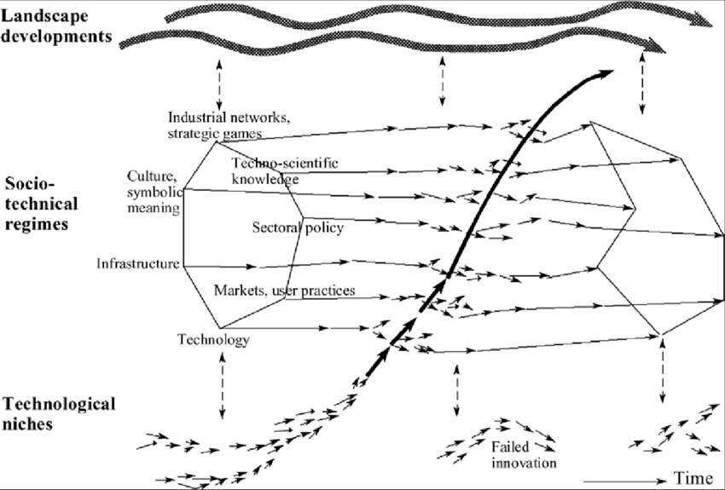
Multi-level perspective (Geels 2002)

Slide 16
Demand-pull innovation
mission-oriented policies are defined as ‘systemic public policies that draw on frontier knowledge to attain specific goals”
Mazzucato (2018:4 EU)
‘Purpose-driven’ innovation
Moonshot approach to innovation e.g. Apollo programme
Grand Challenges

Slide 17
Grand Challenges
New solutions to new problems
Radical innovations-new knowledge
Notes:
They overall shifted the conversation from a bipolarism between advanced and developing economies, towards fundamental needs that had to be met by all countries equally, to varying degrees, present in all countries. The rationale here was an understanding but not acceptance that since the 1980s, income and opportunities had become more and more unequal both in developed and in developing economies due to the asymmetric effect of globalisation, global trade and global production.

Slide 18
Mission-oriented policy and Science & Technology policies
National level coordination and vision (Mowery 2012)
Intentionality of prioritisation (Foray 2018)
Highly specialised institutional capabilities
Top-down
Space blind or neutral
Technology focused
Cross-disciplinary (synergies between green and digital transitions)

Slide 19
Top-down S&T policies and the Technological race
Control over and ownership of the development of new technologies
Global competitors
Avoid technological dependence
Need to impose DIRECTIONALITY
BUT MoIP
ex-ante purpose
push the winner (the best and the brightest)
Appropriability of the mission’s outcome

Slide 20
Space blindness
System change and technological transitions
Grand societal challenges, mission-oriented approach
De Propris and Bailey 2021

Slide 21
Multi-scalarity & multi-purpose
technology
industry
Industrial cluster
Industrial cluster
industry
Industrial cluster
places

Slide 22
What we know
The importance of place started with the literature on industrial districts, cluster, milieux and regional innovation systems (Cooke, Becattini, Bellandi, Crevoisier, Asheim)
The role played by specialisation, accumulation, complexification in the organisation and nature of socio-economic activities has occupied scholars since the 1990s
… concepts such as knowledge, learning, absorptive capacity, dynamic capabilities have scaffolded our understanding of the systemic and spatial nature of innovation processes
Knowledge is cumulative → Path dependency and learning myopia

Slide 23
Evolutionary EG theories on regional development
Path dependency and reg development (Martin & Sunley, 2006)
Branching (Frenken & Boschma 2007)
Regional diversification (Boschma, 2017)
Technological diversification (Rigby, 2015)
Saltation trajectory (Boschma et al 2017
New regional path development (Hassink, Isaksen & Trippl, 2019; Isaksen, Tödling &Trippl, 2018)
Path creation (MacKinnon, Dawley, Pike, & Cumbers, 2018)
“Regions are more likely to develop new specializations in complex technological activities when related to their knowledge bases” Balland, Boschma, Crespo & Rigby 2019

Slide 24
EU Digital Agenda
EU Green Deal
EU level
Grand challenges
National level
MoIP
Local/regional
level
Regional policy
EU Digital Agenda
EU Green Deal
EU cohesion, regional, innovation policies are all bundled
S4 + S5…

Slide 25
EU Digital Agenda
EU Green Deal
EU level
Grand challenges
National level
MoIP
Middle-and-out
Local/regional
level
Regional policy
EU Digital Agenda
EU Green Deal
Bottom-up
EU cohesion, regional, innovation policies are all bundled
S4 + S5…

Slide 26
EU Digital Agenda
EU Green Deal
EU level
Grand challenges
National level
MoIP
Middle-and-out
Local/regional
level
Regional policy
EU Digital Agenda
EU Green Deal
Bottom-up
EU cohesion, regional, innovation policies are all bundled
S4 + S5…

Slide 27
EU Regional policy S3→S4
“the place-based innovation-led S3 transformation agenda should benefit from directionality to tackle societal and planetary challenges. The present Smart Specialisation Cohesion Policy objectives are connected to aim at a smarter Europe by promoting innovative, smart and digital economic transformation.”
JRC Publications Repository - Smart Specialisation, Sustainable Development Goals and Environmental Commons (europa.eu)

Slide 28
Moonshot and beyond
Mazzucato praises
spillover effects across disciplines and sectors
unintended consequences with the development of civil applications
trail of applications across many sectors
Can we trust ‘trickle down effects’?

Slide 29
Technological Change and relentless cumulativeness
Evidence that innovation in and adoption of 4.0 technologies occurs in regions which present some technological nearness
→ suggesting a persistent cleavage between high performing regions and stranded ones
→ Digital and environmental divides at the local/regional levels
Special Issue of Regional Studies: Balland and Boschma, 2021; Corradini et al, 2021; Plechero et al, 2021; and Crespo-Cuaresma and Lutz, 2021; Lenzi and Capello, 2021

Slide 30
Swedish Innovation System
MAKERS - Smart Manufacturing for EU growth and prosperity is a project funded by the Horizon 2020-MSCA- RISE - Grant agreement number 691192.

Slide 31
Sweden
Top 3 or 5 in many innovation indicators
Highly skills human capital
Advanced NIS, infrastructure and policies
Have embraced SDG quickly and worked on green and digital transition
Vinnova, Sweden’s innovation agency

Slide 32
From innovation policy to Impact Innovation*
Place-based programmes specifically targeting the RIS to re-direct or stimulate innovation-driven growth – Vinnväxt (Regional Growth through Dynamic Innovation Systems, launched in 2001) were the precursor of S3 (launched in 2011)
In mid 2010s, Strategic Innovation Programme were launched to cut across sectors and support the development of new technologies between businesses and RO
2022 MO Impact Innovation programme is launched.

Slide 33
Challenge: Understanding where places are wrt their industrial identity and the new technology
Sweden
Vinnvaxt
Mining, mech end
Strategic innovation programme – Production 2030
Notes:
Building back better horizon policy, no sector priority
Infra
Skills and innov
Green agenda
Free ports to soften the negative effect of brexit on trade

Slide 34
Multi-scalar approach to innovation

Slide 35
Need for nested innovation systems, quintuple helix

Slide 36
Takeaways
MOP are S&T policies as EU is competing with the rest of the world | Directionality
Ambition, destination, vision
Prioritising, Selecting, Backing, Excluding
Different from innovation policies, systemic and place-based
Path dependency vs new starts

Slide 37
Thank you l.depropris@bham.ac.uk

