Slide 1
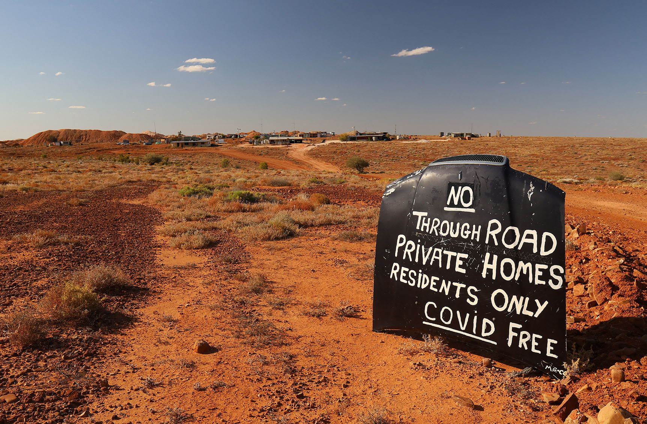
RSA Winter Conference
London
Tough times in Struggle City: The perspective of disadvantaged communities on Covid-19 impacts
11 November 2022
Professor Andrew Beer
Executive Dean, UniSA Business
PHOTOS: SANDY HORNE

Slide 2
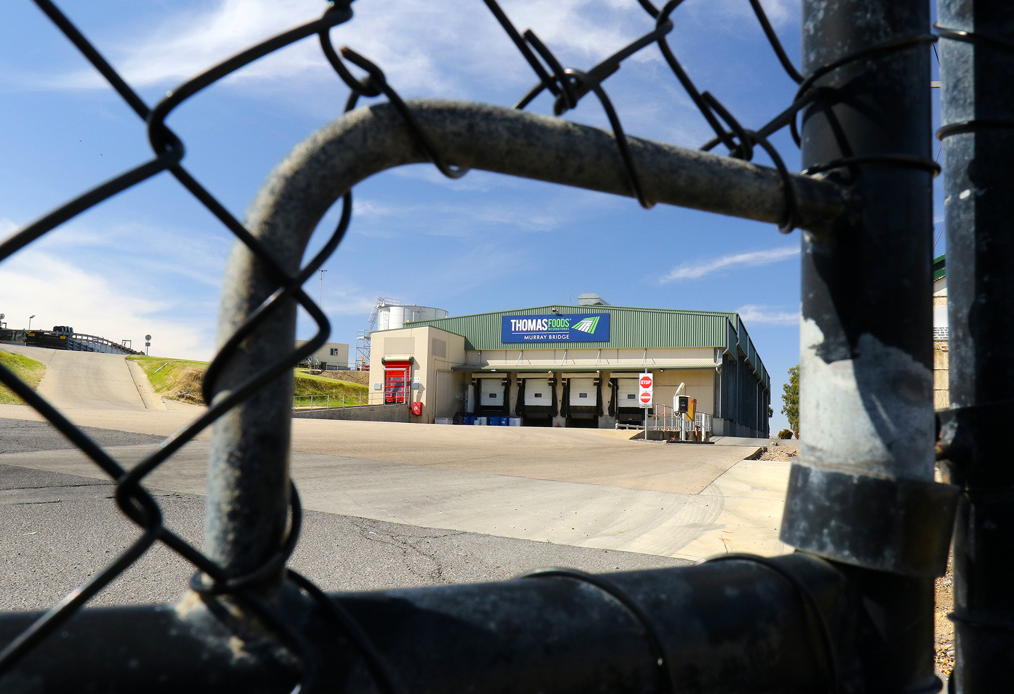
COVID and vulnerability indices
Onset of COVID-19 has resulted in a number of indices produced of vulnerability to COVID
Most have been based on a combination of industry composition regionally, and labour force characteristics – eg income and educational attainment
These indices highlight regions with concentrations in the most affected industries as especially vulnerable
Eg tourism, meatworks etc
But is it the case that economic structure alone determines vulnerability?
And, do already vulnerable regions suffer more from COVID?

Slide 3
Survey insights
Primary data collection via survey of regions affected by auto closure and the broader metropolitan regions
All things being equal, we would expect poorer working class regions to be more at risk
As they are more likely to have a concentration of affected industries
Eg working from home is not an option in manufacturing, unlike professional services
One of the places studied was Melbourne
512 days of hard lockdown over the period 2020 and 2021
Not all affected workers received government provided support through COVID

Slide 4
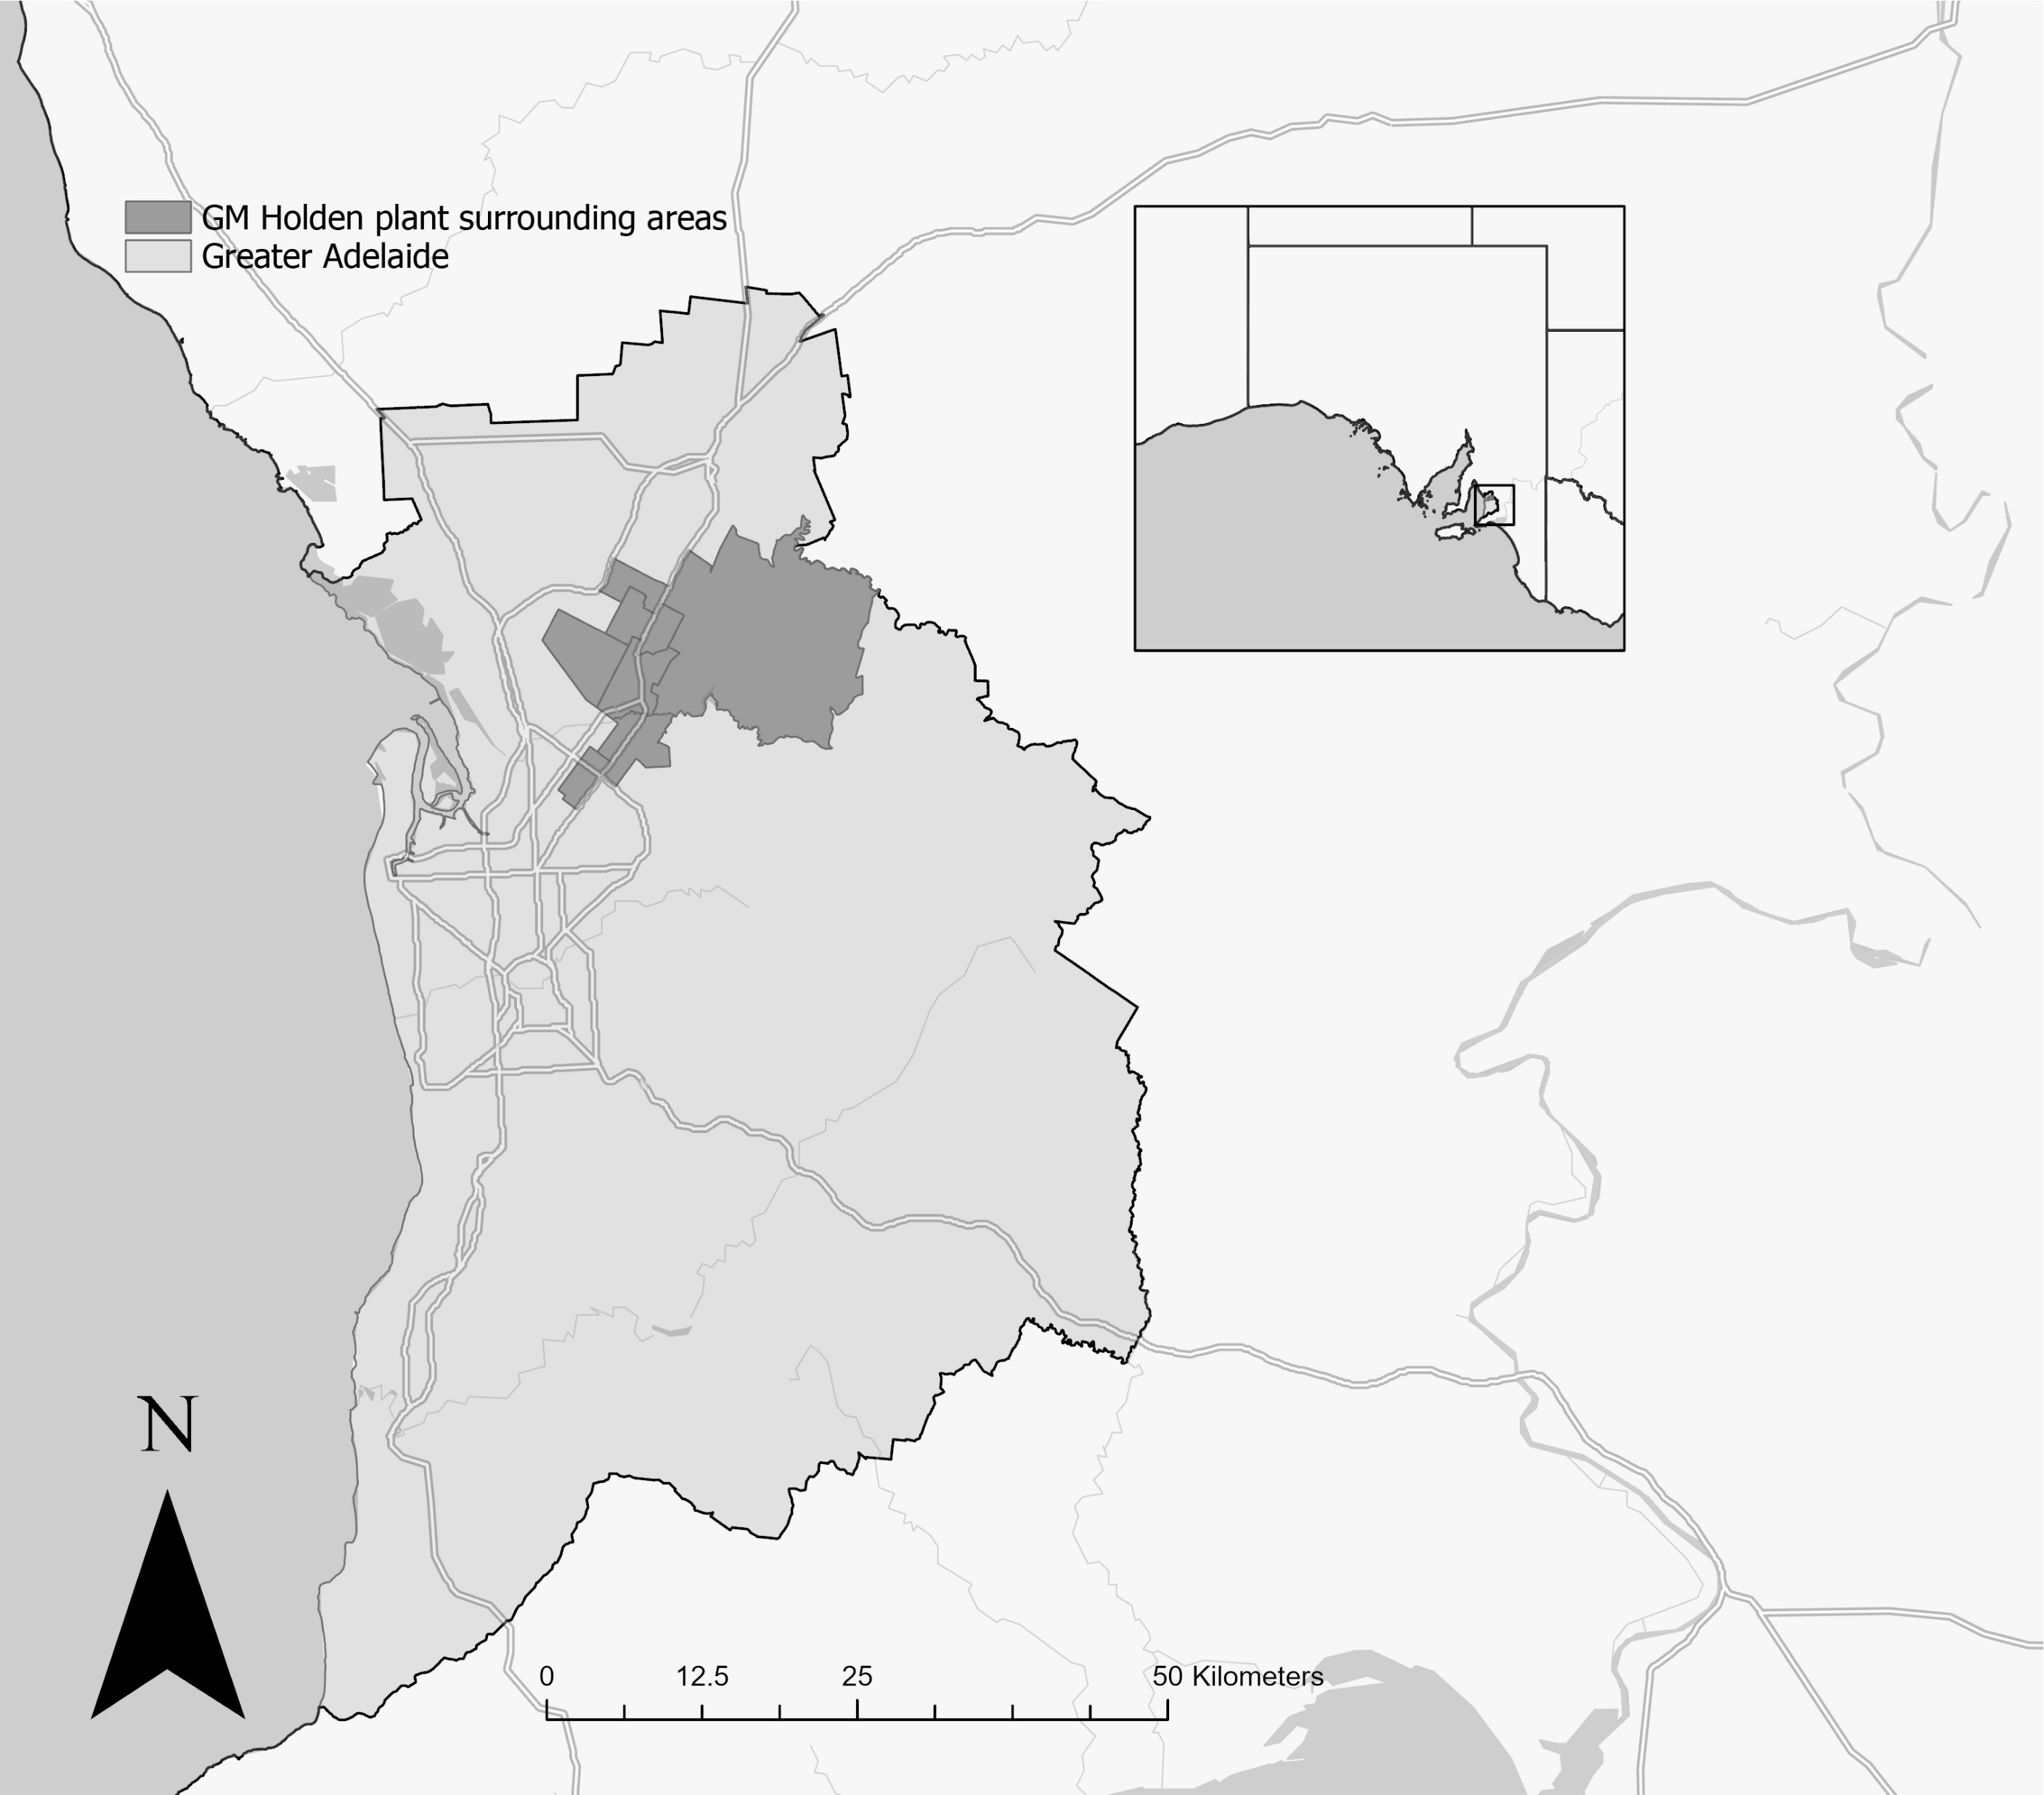
Case study site in South Australia

Slide 5
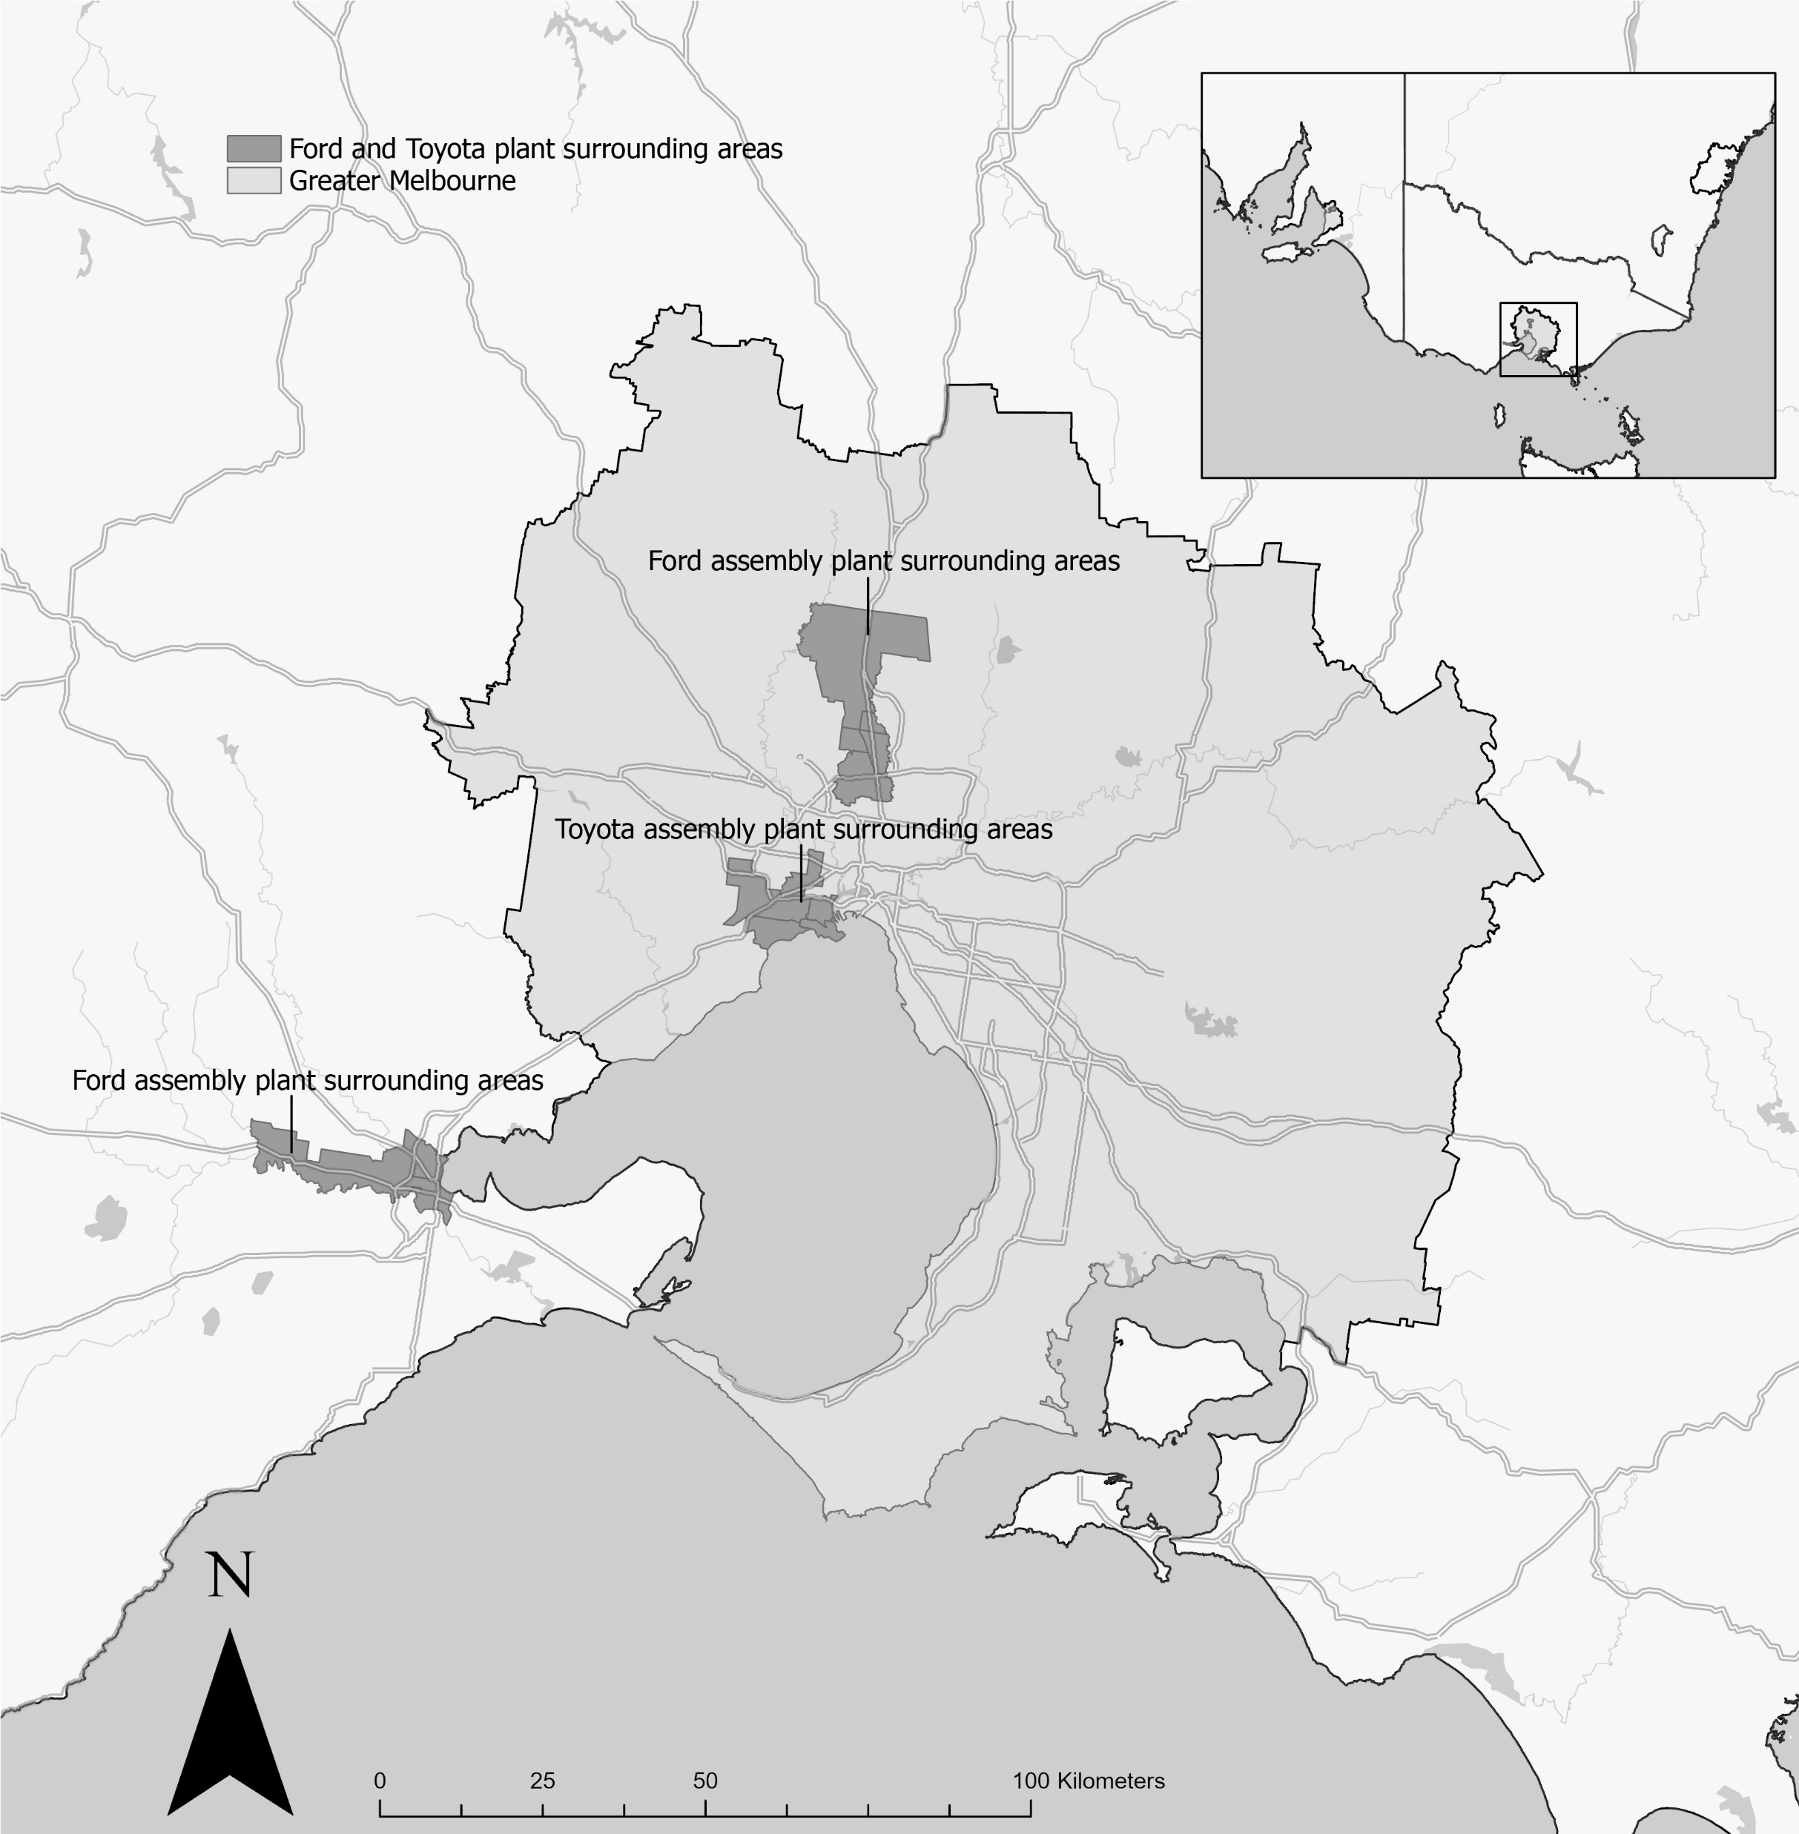
Case study sites in Victoria

Slide 6
Perceived financial vulnerability
Under 60 years
Entire population
Q20. How concerned are you about the following areas due to COVID-19? – My financial position
Q20. How concerned are you about the following areas due to COVID-19? – My financial position

Slide 7
Perceived employment security
Under 60 years
Entire population
Q20. How concerned are you about the following areas due to COVID-19? – My job
Q20. How concerned are you about the following areas due to COVID-19? – My job

Slide 8
Perceived freedom to enjoy life
Under 60 years
Entire population
Q20. How concerned are you about the following areas due to COVID-19? – My freedom to enjoy life
Q20. How concerned are you about the following areas due to COVID-19? – My freedom to enjoy life

Slide 9
Perceived access to basic necessities
Under 60 years
Entire population
Q20. How concerned are you about the following areas due to COVID-19? – My access to basic necessities
Q20. How concerned are you about the following areas due to COVID-19? – My access to basic necessities

Slide 10
Difficulty paying the mortgage
Under 60 years
Entire population
Q25A. Due to the financial stress of COVID-19, has your household not been able to do any of the following things? – Pay your mortgage
Q25A. Due to the financial stress of COVID-19, has your household not been able to do any of the following things? – Pay your mortgage

Slide 11
Difficulty paying the rent
Under 60 years
Entire population
Q25A. Due to the financial stress of COVID-19, has your household not been able to do any of the following things? – Pay your rent
Q25A. Due to the financial stress of COVID-19, has your household not been able to do any of the following things? – Pay your rent

Slide 12
Conclusions
Our data suggest, that for Australia at least
Industry structure and labour force characteristics are not the only determinants of economic risk arising from COVID
Age profile has an important moderating impact
Older populations already out of the workforce do not experience additional economic hardship as a result of COVID
Questions should be asked about what other factors may affect economic vulnerability in a time of crisis

