Slide 1
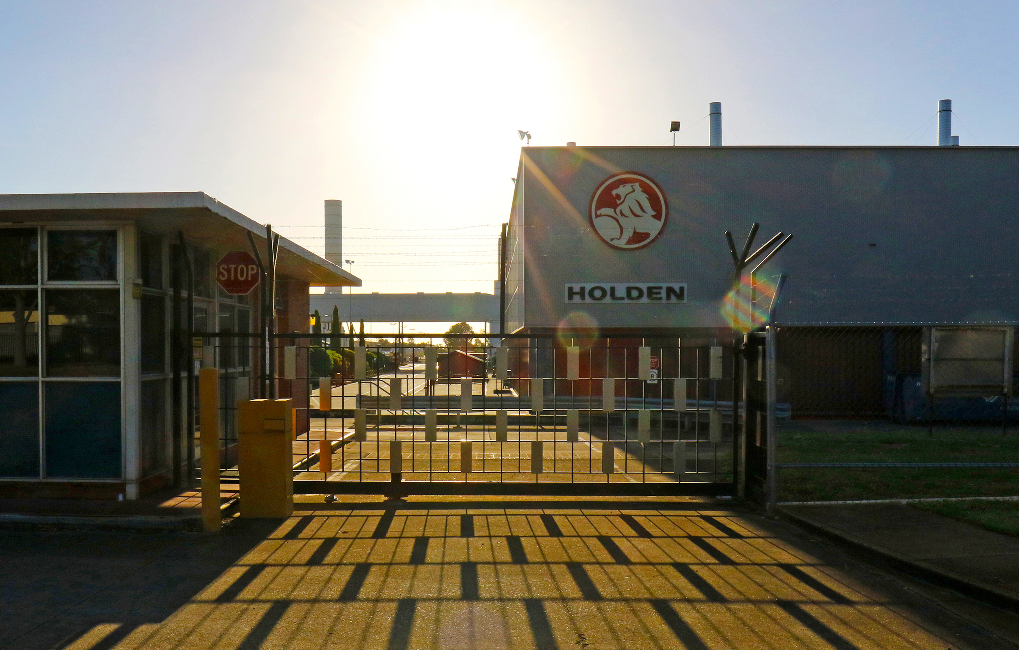
RSA Winter Conference
London
11 November 2022
Jacob Irving – presenting PhD Candidate and Project Officer, UniSA Business
Akshay Vij Associate Professor, UniSA Business
Sally Weller Associate Professor, UniSA Business
Andrew Beer Executive Dean, UniSA Business
PHOTOS: SANDY HORNE
Labour Market Preferences in a Changing World of Work: A Discrete Choice Experiment

Slide 2
Job displacement and the search for meaningful work
Displaced workers
Workers experience wage loss and insecure work conditions when re-entering the labour force
Meaningful work
Preferences for good wages comes second to job interest, work appreciation and organisational inclusivity
Workers place value on autonomy, competence and work relationships
Positive predictor of productivity, organisational behaviour and quality of goods and services
Negative predictor of absenteeism, retirement intentions, poor performance and labour turnover
Our study provides insights on:
Job preferences of displaced workers and compensating wage differentials for job attributes of meaningful work
Degree of heterogeneity in displaced worker preferences

Slide 3
Discrete Choice Experiment
Online Stated Preference Survey
Administered December 2021 to Feb 2022
309 respondents
Active in the labour market – employed/unemployed
Retrenched during the automotive plant closures in Australia

Slide 4
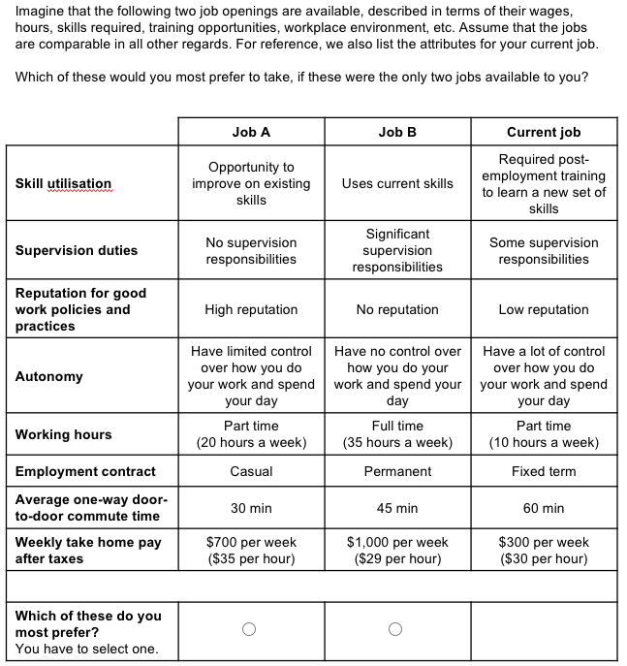
Question Example
Job choices
Current job shown for reference

Slide 5
Question Example
Job choices
Current job shown for reference
Attributes

Slide 6
Question Example
Job choices
Current job shown for reference
Attributes

Slide 7
Scale of levels for each attribute
Attribute Design
Attribute | Level 1 | Level 2 | Level 3 | Level 4
Skill utilisation | Opportunity to improve on existing skills | Uses current skills | Requires pre-employment training to learn a new set of skills | Requires post-employment training to learn a new set of skills
Supervision duties | No supervision responsibilities | Some supervision responsibilities | Significant supervision responsibilities | -
Reputation for good work policies and practices | High reputation | Medium reputation | Low reputation | No reputation
Autonomy | Have some control over how you do your work and spend your day | Have no control over how you do your work and spend your day | Have a lot of control over how you do your work and spend your day | -
Working hours | Full time (Approx. 35 hours a week) | Full time (Approx. 35 hours a week) | Part time (Approx. 20 hours a week) | Part time (Approx. 10 hours a week)
Employment Contract | Permanent | Casual | 1 year fixed term | -
Average one-way door-to-door commute time | 20 minutes | 30 minutes | 45 minutes | 60 minutes
Weekly take home pay after taxes | Continuous number that can vary between -20% and +20% of their current salary (for individuals currently in paid employment, use middle of current salary range; for individuals currently unemployed, use middle of salary range when their contract in the auto industry ended)

Slide 8
Scale of levels for each attribute
Attribute Design
Attribute | Level 1 | Level 2 | Level 3 | Level 4
Skill utilisation | Opportunity to improve on existing skills | Uses current skills | Requires pre-employment training to learn a new set of skills | Requires post-employment training to learn a new set of skills
Supervision duties | No supervision responsibilities | Some supervision responsibilities | Significant supervision responsibilities | -
Reputation for good work policies and practices | High reputation | Medium reputation | Low reputation | No reputation
Autonomy | Have some control over how you do your work and spend your day | Have no control over how you do your work and spend your day | Have a lot of control over how you do your work and spend your day | -
Working hours | Full time (Approx. 35 hours a week) | Full time (Approx. 35 hours a week) | Part time (Approx. 20 hours a week) | Part time (Approx. 10 hours a week)
Employment Contract | Permanent | Casual | 1 year fixed term | -
Average one-way door-to-door commute time | 20 minutes | 30 minutes | 45 minutes | 60 minutes
Weekly take home pay after taxes | Continuous number that can vary between -20% and +20% of their current salary (for individuals currently in paid employment, use middle of current salary range; for individuals currently unemployed, use middle of salary range when their contract in the auto industry ended)

Slide 9
Scale of levels for each attribute
Attribute Design
Attribute | Level 1 | Level 2 | Level 3 | Level 4
Skill utilisation | Opportunity to improve on existing skills | Uses current skills | Requires pre-employment training to learn a new set of skills | Requires post-employment training to learn a new set of skills
Supervision duties | No supervision responsibilities | Some supervision responsibilities | Significant supervision responsibilities | -
Reputation for good work policies and practices | High reputation | Medium reputation | Low reputation | No reputation
Autonomy | Have some control over how you do your work and spend your day | Have no control over how you do your work and spend your day | Have a lot of control over how you do your work and spend your day | -
Working hours | Full time (Approx. 35 hours a week) | Full time (Approx. 35 hours a week) | Part time (Approx. 20 hours a week) | Part time (Approx. 10 hours a week)
Employment Contract | Permanent | Casual | 1 year fixed term | -
Average one-way door-to-door commute time | 20 minutes | 30 minutes | 45 minutes | 60 minutes
Weekly take home pay after taxes | Continuous number that can vary between -20% and +20% of their current salary (for individuals currently in paid employment, use middle of current salary range; for individuals currently unemployed, use middle of salary range when their contract in the auto industry ended)

Slide 10
Scale of levels for each attribute
Attribute Design
Attribute | Level 1 | Level 2 | Level 3 | Level 4
Skill utilisation | Opportunity to improve on existing skills | Uses current skills | Requires pre-employment training to learn a new set of skills | Requires post-employment training to learn a new set of skills
Supervision duties | No supervision responsibilities | Some supervision responsibilities | Significant supervision responsibilities | -
Reputation for good work policies and practices | High reputation | Medium reputation | Low reputation | No reputation
Autonomy | Have some control over how you do your work and spend your day | Have no control over how you do your work and spend your day | Have a lot of control over how you do your work and spend your day | -
Working hours | Full time (Approx. 35 hours a week) | Full time (Approx. 35 hours a week) | Part time (Approx. 20 hours a week) | Part time (Approx. 10 hours a week)
Employment Contract | Permanent | Casual | 1 year fixed term | -
Average one-way door-to-door commute time | 20 minutes | 30 minutes | 45 minutes | 60 minutes
Weekly take home pay after taxes | Continuous number that can vary between -20% and +20% of their current salary (for individuals currently in paid employment, use middle of current salary range; for individuals currently unemployed, use middle of salary range when their contract in the auto industry ended)

Slide 11
Scale of levels for each attribute
Attribute Design
Attribute | Level 1 | Level 2 | Level 3 | Level 4
Skill utilisation | Opportunity to improve on existing skills | Uses current skills | Requires pre-employment training to learn a new set of skills | Requires post-employment training to learn a new set of skills
Supervision duties | No supervision responsibilities | Some supervision responsibilities | Significant supervision responsibilities | -
Reputation for good work policies and practices | High reputation | Medium reputation | Low reputation | No reputation
Autonomy | Have some control over how you do your work and spend your day | Have no control over how you do your work and spend your day | Have a lot of control over how you do your work and spend your day | -
Working hours | Full time (Approx. 35 hours a week) | Full time (Approx. 35 hours a week) | Part time (Approx. 20 hours a week) | Part time (Approx. 10 hours a week)
Employment Contract | Permanent | Casual | 1 year fixed term | -
Average one-way door-to-door commute time | 20 minutes | 30 minutes | 45 minutes | 60 minutes
Weekly take home pay after taxes | Continuous number that can vary between -20% and +20% of their current salary (for individuals currently in paid employment, use middle of current salary range; for individuals currently unemployed, use middle of salary range when their contract in the auto industry ended)

Slide 12
Key findings 1 – worker preferences
Autonomy, and employer reputation for good work policies and practices, are the two most important non-pecuniary job attributes, with compensating wage differentials around 5 AUD per hour (3.5 USD)
Job security (as denoted by contract tenure) and skill utilisation are also important, but less so than the above attributes, with compensating wage differentials around between 1 AUD and 3 AUD per hour (.7 USD to 2 USD).
Supervision duties do not seem to be an important attribute, showing up as insignificant in the model.

Slide 13
Summary statistics for responses to different attitudinal statements
Statement | Distribution of responses |  |  |  |  | Mean score
 | 1 - Strongly disagree |  |  |  | 5 - Strongly agree
To what extent do you agree or disagree with the following statements about your willingness to take on a different job from your current/previous employment?
I prefer to continue to work in my usual occupation | 3.9% | 10.0% | 30.7% | 33.0% | 22.3% | 3.60
I would consider branching out into a related occupation | 5.8% | 15.2% | 30.7% | 38.8% | 9.4% | 3.31
I am ready for a change of occupation, I want to try something different | 19.1% | 23.0% | 31.1% | 18.4% | 8.4% | 2.74
I would accept work in another occupation while I continue to search for my preferred work | 17.5% | 24.9% | 26.9% | 22.3% | 8.4% | 2.79
I might have to accept work in another occupation to put food on the table | 33.3% | 21.4% | 21.7% | 13.3% | 10.4% | 2.46
I do not much care what I do for work, as long as I get paid | 32.7% | 31.7% | 20.7% | 9.4% | 5.5% | 2.23
It is important that what I do uses my existing skills and abilities | 1.6% | 8.7% | 24.6% | 42.7% | 22.3% | 3.75
I would be willing to retrain to qualify for work in a new occupation | 5.2% | 11.7% | 28.2% | 32.0% | 23.0% | 3.56
Travel time to work plays a significant role in my choice of workplace | 2.9% | 12.0% | 24.9% | 34.0% | 26.2% | 3.69

Slide 14
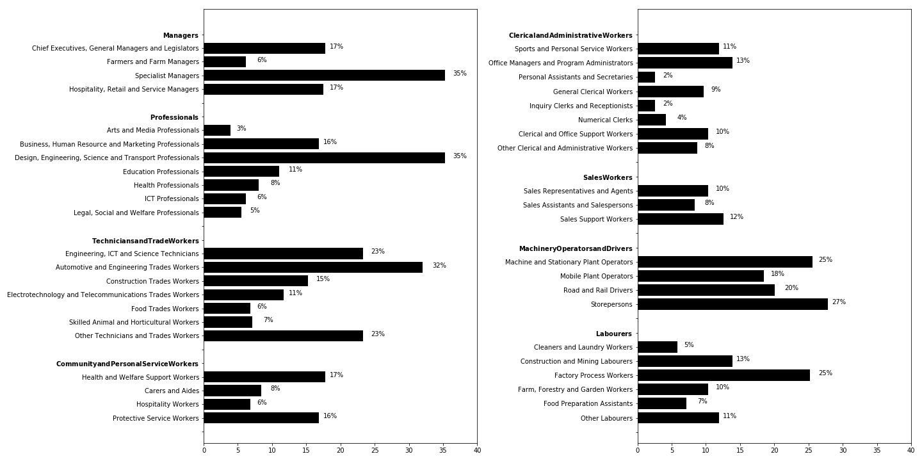
Proportion of respondents that indicated they would be interested in working in different occupations

Slide 15
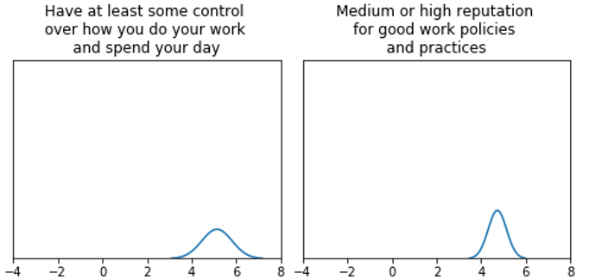
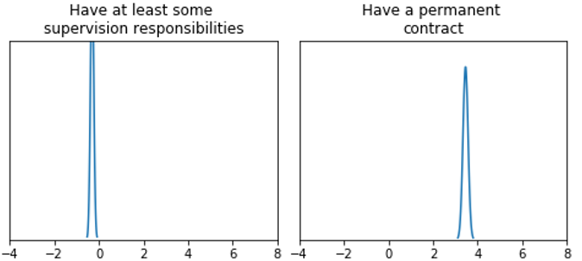
Key finding 2 – homogeneity

Slide 16
Key finding 3 – degrees of heterogeneity
Systematic heterogenous worker preferences – GENDER

Slide 17
Key finding 3 – degrees of heterogeneity
Systematic heterogenous worker preferences – AGE

Slide 18
Key finding 3 – degrees of heterogeneity
Systematic heterogenous worker preferences – COUNTRY OF BIRTH

Slide 19
Conclusions
Our data show
Soft attributes of work matter most to workers transitioning into new work after displacement
Worker autonomy and firm reputation for good work policies and practices matter most
Job security and skill utilisation are nevertheless important
Preferences are mostly homogenous in our sample
Gender, age and country of birth do play some role in worker preferences
Governments and large firms have a significant role to play in managing labour market disruptions

