Slide 1
Labour market preferences of retrenched Australian auto industry workers for job quality and meaningful work
Presenter: Lynette Washington
Authors: Akshay Vij, Lynette Washington, Sally Weller,
Jacob Irving & Ilke Onur

Slide 2
Overview
Stated Preference Experiments - what redundant auto industry workers look for when re-entering the workforce
Workers’ strongest preference - not for a particular kind of work, but rather for a particular type of employer

Slide 3
Context of study
Background to industry closure
2017 ‘end of an era’
Between 40,000 and 50,000 jobs lost
Retreat of labour-intensive manufacturing from developed nations

Slide 4
Data set
309 retrenched auto workers in Australia between 2020 and 2021
Sample consistent with Australian Census data
Demographic diversity

Slide 5
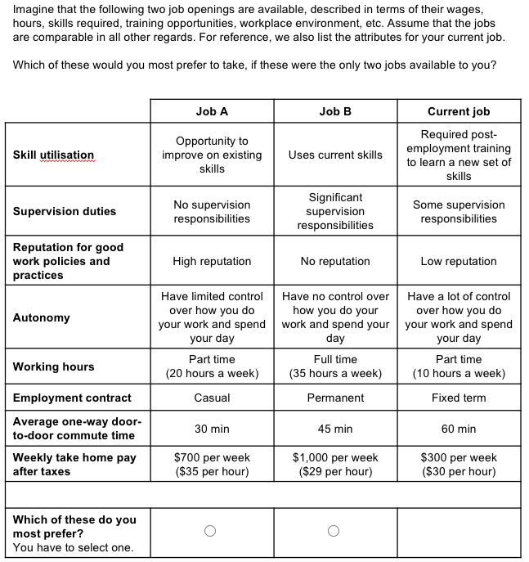
Methodology - Stated Preference Experiment

Slide 6
Overview of theoretical framework
Meaningful work, job interest, job quality
Worker displacement – research and policy focus

Slide 7
Key findings
We found compensating wage differentials for:
Autonomy and employer reputation for good work policies and practices AUD$5 per hour
Job security and skill utilisation between AUD$1 and $3 per hour

Slide 8
Two most important non-pecuniary attributes
AUD$5 per hour wage differential:
Better employer reputation
Greater autonomy
Australian minimum wage: AUD$20 p/h
Sample average wage: AUD$32 p/h

Slide 9
Other non-pecuniary job attributes
Greater job security
Fewer training requirements (skill utilisation)
Commute time
Occupation

Slide 10
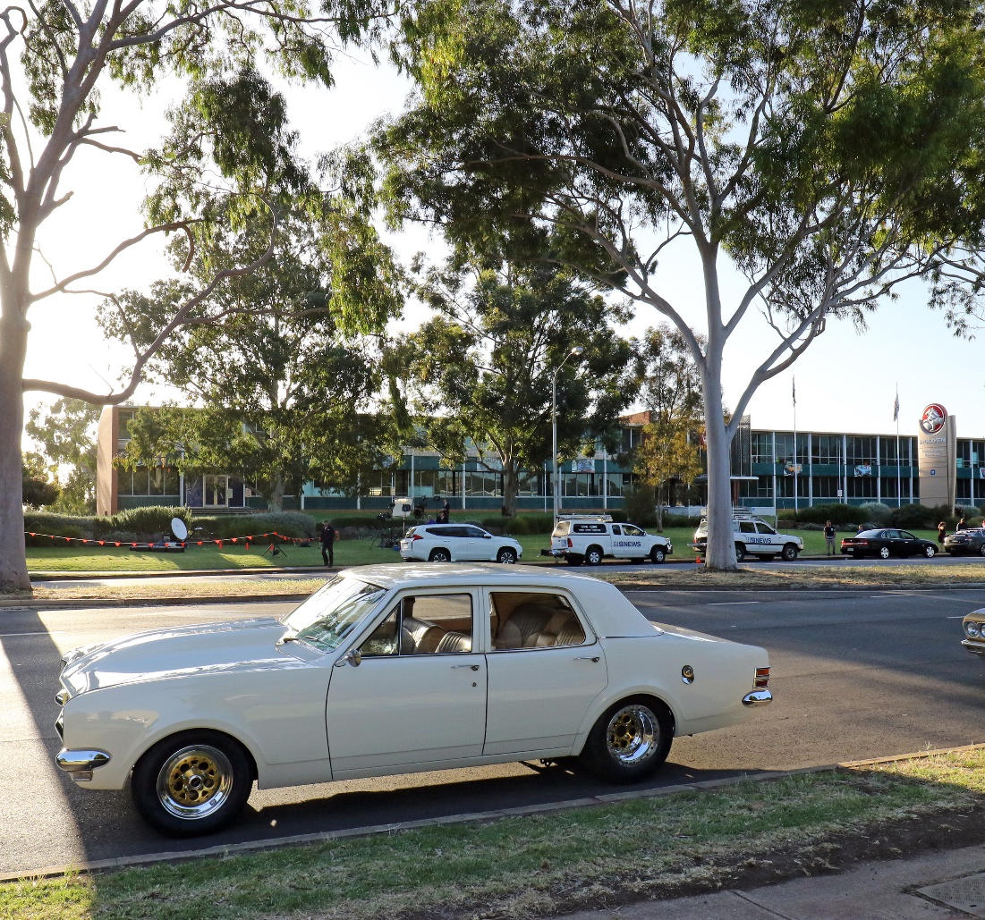
Unimportant job attributes
Supervision duties

Slide 11
Heterogeneity - discrimination
Women, older workers, tertiary educated workers, and those born outside Australia value autonomy, employer reputation and job security more
They also value skill development/training more

Slide 12
Heterogeneity – skill utilisation and training
Pre-employment training AUD$2-$3 CWD
Post-employment training – split

Slide 13
Heterogeneity – household composition & wealth
Workers with children
Workers in households with other adults
Current employment, home ownership, redundancy payments

Slide 14
Three contributions
New insights into non-pecuniary preferences of retrenched workers
Heterogeneity and workplace discrimination
Implications for labour and industrial policy

Slide 15
Impact for future labour markets
Manufacturing jobs in decline
Focus on propping up industry and re-employing redundant workers
Gap – understanding what workers want

Slide 16
Policy implications
Broaden structural adjustment programs
Primary focus on non-pecuniary preferences of workers – such as autonomy and employer reputation – rather than matching skill sets or filling labour supply gaps
Workers’ strongest preference is not for a particular type of work, but rather for a particular type of employer, suggesting that labour market policy might pay more attention to regulating the quality of workplaces.

Slide 17
This work was supported by the Australian Research Council [grant number LP170100940]. We thank Ali Ardeshiri for assistance with experiment design, Karen Cong for programming and administering the survey, Jacob Irving for assisting with demographics, and Andrew Beer for his guidance and support through the study. Finally, we thank all study participants.
Photo credit: Sandy Horne

