Slide 1
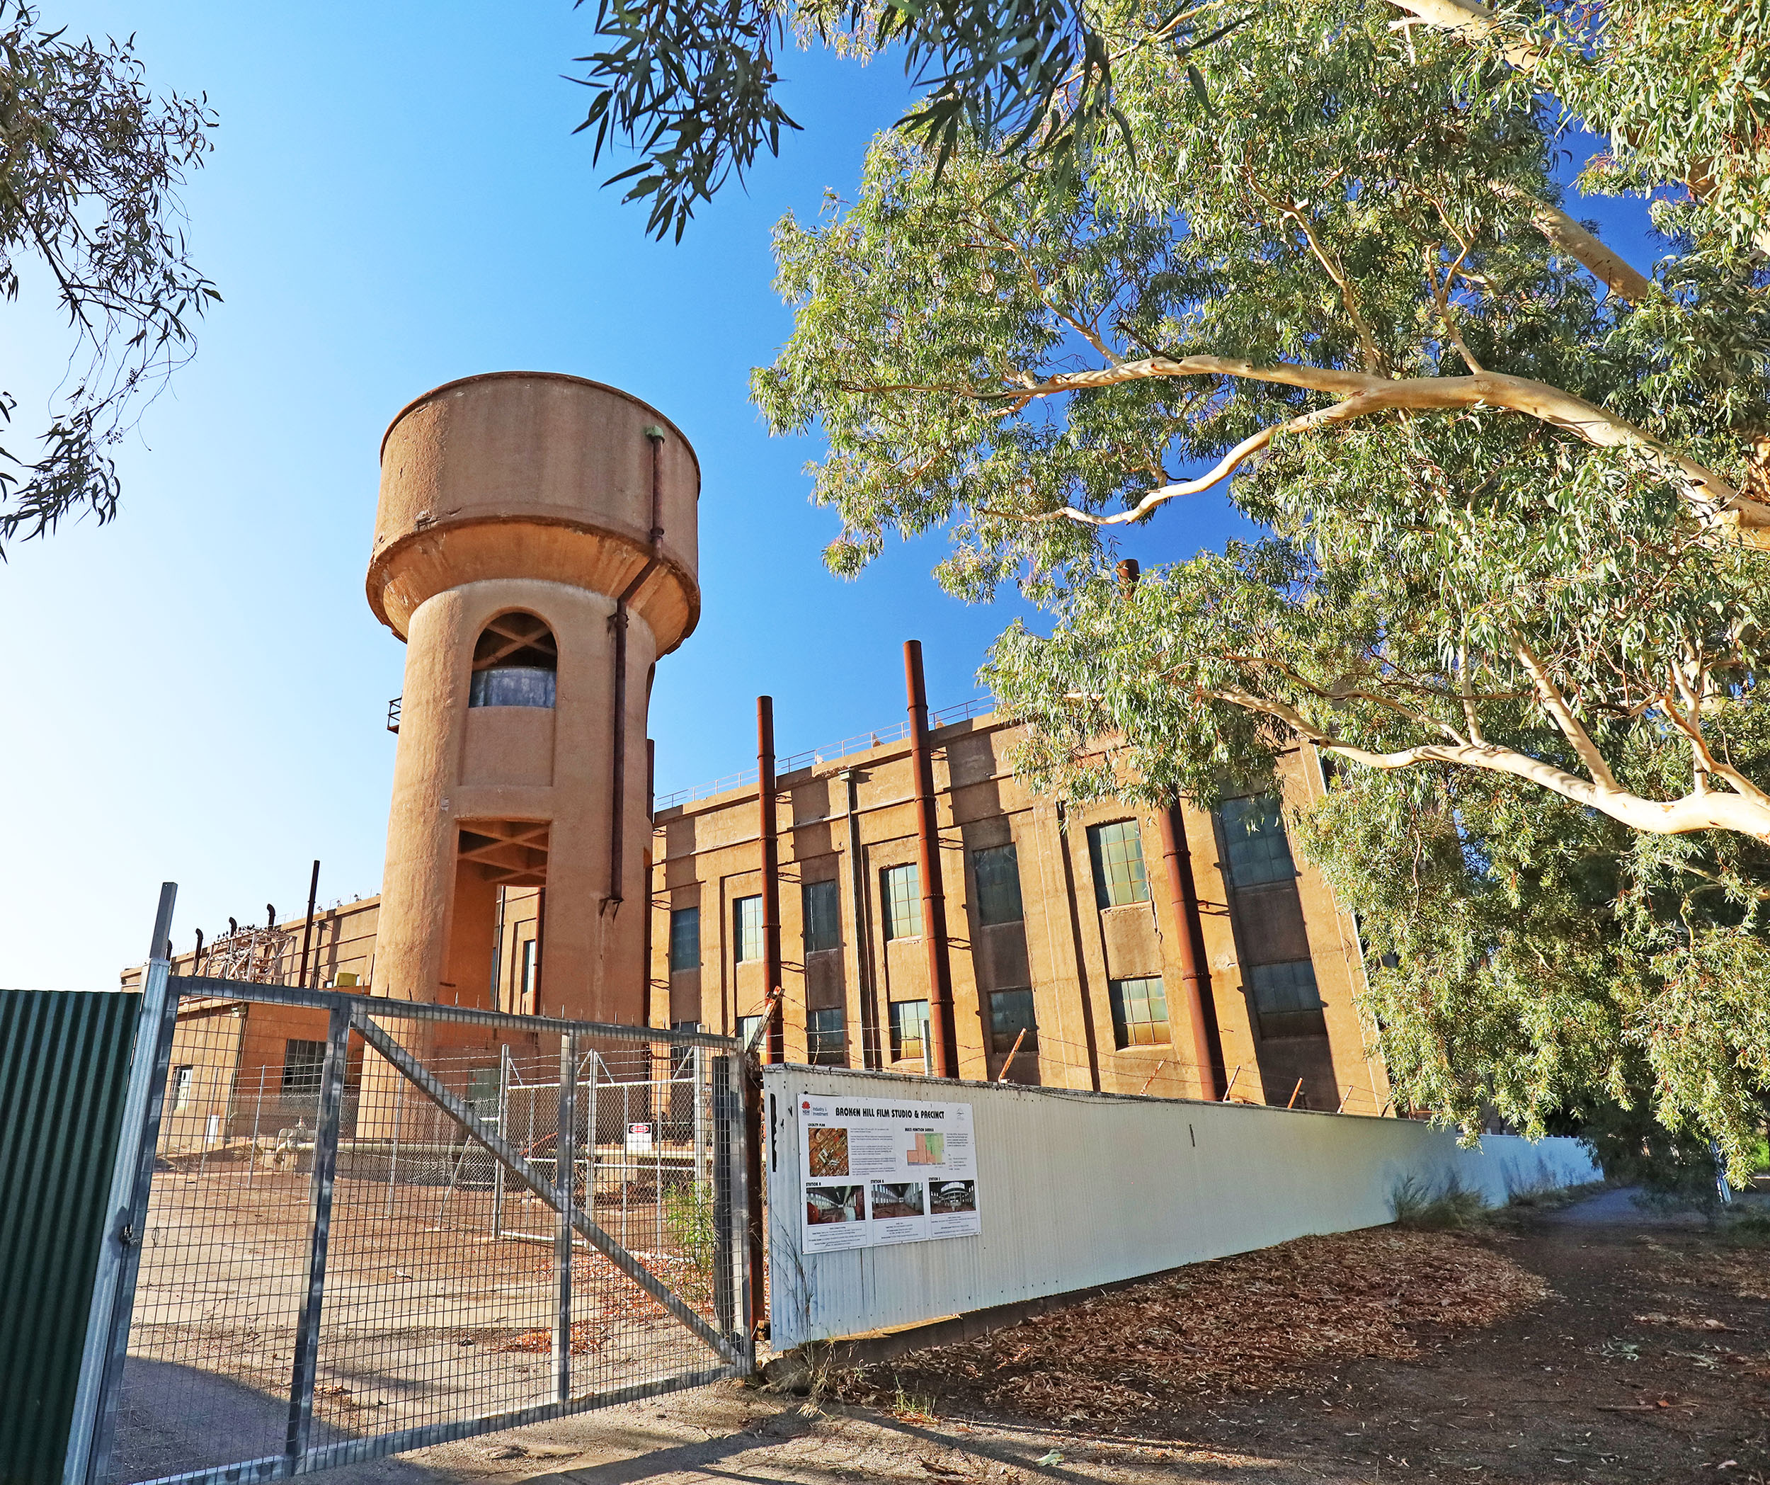
Agency and the structural determinants of regional growth: Towards a retheorisation
Helen Dinmore University of South Australia https://orcid.org/0000-0002-8625-7119
Andrew Beer University of South Australia https://orcid.org/0000-0002-9255-3985
Jacob Irving University of South Australia https://orcid.org/0000-0002-4609-0377
Markku Sotarauta Tampere University, Finland https://orcid.org/0000-0001-6603-6370
2023 RSA Annual Conference
Ljubljana, Slovenia
15 June 2023

Slide 2
Introduction
This paper addresses debates on the role of agency in shaping the economic future of regions.
Scholarship on agency departs from the earlier focus of evolutionary economic geography, which highlighted the role of pre-existing structural conditions.
This presentation challenges the notion agency is only found in intentional action and is limited to key actors within a region.
It questions the exclusive focus on the impact of entrepreneurial leaders, place leaders and government, and identifies agency in the accumulated micro-decisions of multiple decision makers, using the example of workers affected by the closure of Australia’s passenger vehicle industry.
PHOTOS: SANDY HORNE

Slide 3
Agency
A flourishing of interest in the question of agency and its capacity to shape the growth trajectories of regions, especially those experiencing externally-induced change (MacKinnon et al. 2019; Morisson & Mayer 2021; Gong et al. 2022).
The newly reawakened interest in human agency has been built on the belief it is possible to add analytical leverage to the question of why some regions develop better (or worse) than others, and does so by linking actors to structural processes.
Emirbayer and Mische’s (1998) definition of agency as an ‘action or intervention to produce a particular effect’ – enhancing a region’s economic, societal or ecological prosperity.
Writing on agency has sought to extend the analytical lens from shedding light on the impact of structural factors – such as pre-existing institutions and the history of development in that region – to include insights into the role of individual decisions and behaviours in determining economic outcomes at that scale.

Slide 4
Agency
De Propris and Bailey (2021) have argued for foundational EEG the evolution of a region is most likely to take place through transition to related industries that use technologies and knowledge already present in that locality, which must be amenable to new applications and further advancement.
Put more simply, the history of economic and social development in a region – including the nature and structure of firms in that locality, workforce capacity and institutionals – determines the probability of further economic development, as well as its nature and composition.
This perspective emphasises prior structural conditions, but also implies some places are unable to explore new development pathways due to limitations embedded in their industrial structure – for example, regions dominated by declining industries – and because of ‘lock in’ due to ‘systemic resistance of the incumbent stakeholders to consider technological change in order to preserve the mature technology’.
Path dependence makes select future development avenues more probable than others (Grillitsch & Trippl 2018) but does not determine outcomes (Martin & Sunley 2006). Therefore, there is a need to examine how the engagement of actors influences the unfolding of events (Hassink, Isaksen, & Trippl 2019).

Slide 5
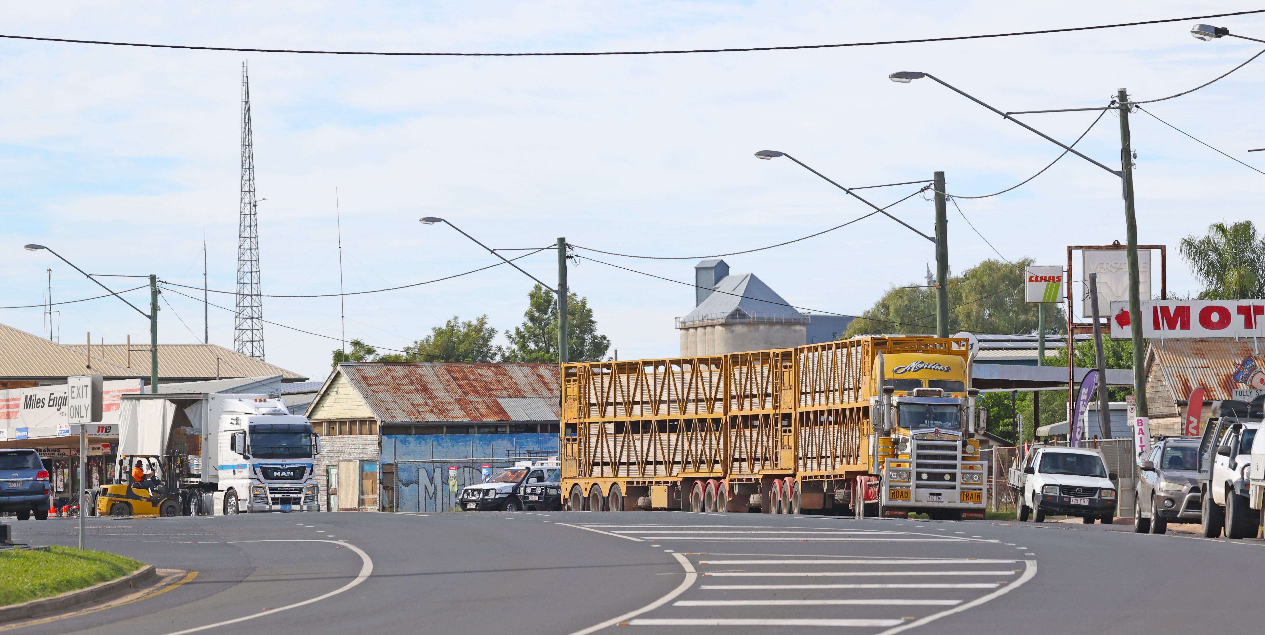
Agency as a the decision to act: Intent
Finally, in the context of regional development, the change agency literature overwhelmingly posits that agency is a quality that sits with those who choose to act and have the power to exert an influence at the regional scale. As Grillitsch et al. (2022 p6) stated
agency is best understood as distributed between a set of intentional actors and a strategic driver for change.
This definition reflects commonly selected units of analysis and implies a high degree of intentionality; that actors are relatively powerful and overtly aware of their influence; and, finally, that they are deliberate in their behaviours and decision making – taking purposeful steps to bring about change.

Slide 6
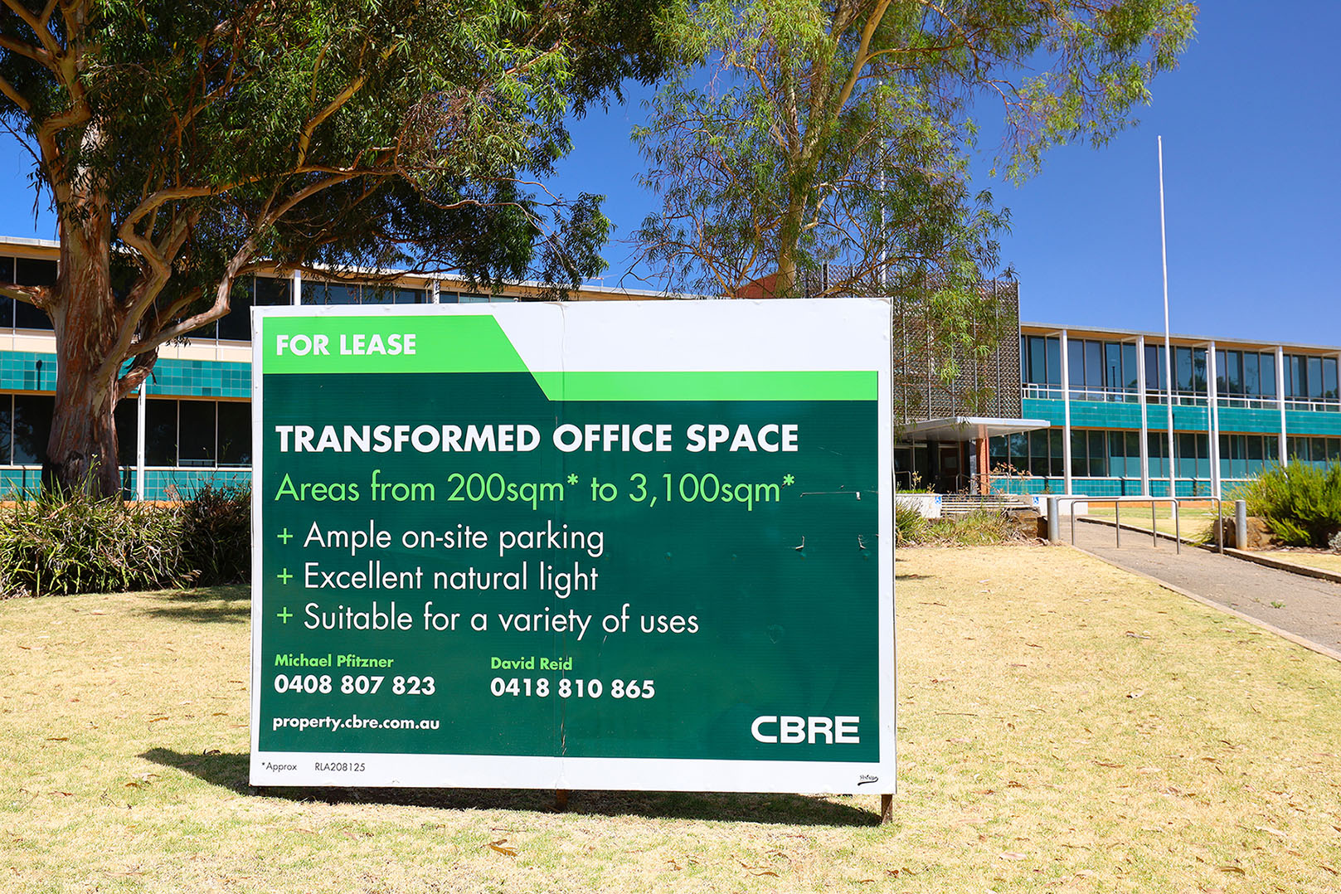
Closure of the passenger vehicle industry

Slide 7
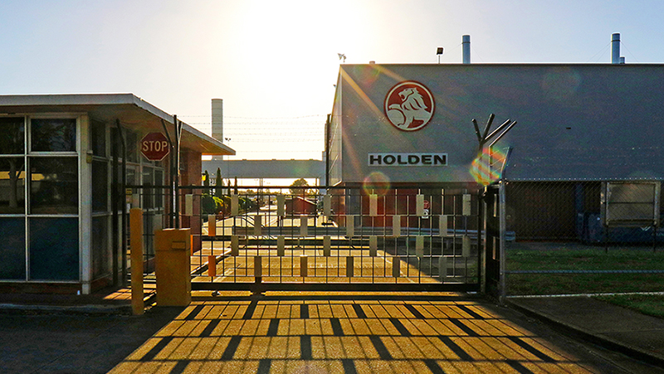
Workers as decision makers
The agency literature implies that key individuals make informed, intentional decisions that bring about change
But what happens when those kept out of decision making have to act?
Do they appreciate that their decisions/actions have consequences?
Have they been informed that the future of their home city or region may be affected by their individual decisions?
And what decisions do they make?

Slide 8
Workers as decision makers
Upon closure some workers were offered career counsellors, while others attended information sessions about openings in other industries, such as construction, defence and aged care. Participants reported their own ideas about what the future would hold were often in conflict with the options presented to them:
They put stuff forward, you know, they said do you want to do a manager’s job again or a supervisor? I said no. Team leader job role? No. Then they said, how about looking after old people, and I said definitely not. Because I just basically said, look, don’t even worry about me. I was confident that I would find a job. (12)
The reskilling, it didn’t really help me actually, basically in any of those jobs, seminars what they did, it didn’t attract me any of the skills. They were encouraging people to do more in the construction industry … most of the things they were using (as examples were) construction and disability support. I wasn’t interested in that sort of skilling. (7)
In our group at work, everybody had their own vision of what they wanted to do. (13)

Slide 9
Workers as decision makers
For some participants, the barrier was that they lacked a vision of what they wanted to do. They reported they needed personalised advice from service providers, and fewer generalised suggestions:
I didn’t know what I wanted to do. I didn’t know what I was doing …. What I would say yes to more is I’d needed more guidance. Maybe. And I’d been in one place all my life. Real world’s different when you work in the same place since you’re 15. (26)
I’m spewing I didn’t do something along the carers’ role. I was a bit uneducated. (23)
They didn’t tell us exactly. ‘Oh, you can do whatever.’ But what is ‘whatever’? I don’t know whatever it is, but explain it to me please. But they didn’t … they go, oh what would you like to do? I really had no idea, I just want a job. (28)
Well, I found that [the courses] were good. But like I sort of, I made the wrong decision. I chose to do that beauty course, and I probably shouldn’t have gone down that avenue. (19)

Slide 10
‘I just never got around to it’
There were many reasons for disengagement with training programs. Some participants did not perceive upgrading their skills would improve their value in the labour market:
I normally would do a course or try to better myself. But … I didn’t do anything like that, because I thought that I had enough skills to get me through. (2)
I think a lot more people stayed with what they knew, and just tried to consider jobs in other companies. [My company name] was a big ticket. … So I just stayed within the industry at that stage and just looked at other work. (27)
To do programs, you had to do courses and things like that, but you weren’t guaranteed a job at the end of it. So I refused to do all that and just found myself a job. There’s plenty of jobs out there if people want them. (15)
One supervisor described the attitudinal barriers he observed among workers in his team:
If it was in company time, and they were going to see someone and talk to them, they’d participate a bit. But if they had to go off and do something themselves in their own time, they wouldn’t do it … there was there was all this help for them, but they wouldn’t engage in it … For example, in the end, I had 20 guys on site, probably at least 75% of them just didn’t really want to participate in any of it … A lot of them felt lost, and then didn’t want to do anything to try and work their way around that. Then others thought, oh well, I’m going to get a redundancy, that money’s – you know, I’m getting X amount of dollars. And they didn’t think they needed to see past that. (6)

Slide 11
‘I just never got around to it’
We may not normally characterise this kind of disengagement as decisive, in the sense that it constitutes an active choice. However, the experiences of retrenched workers show how passive decision making (e.g. a failure to act on reskilling opportunities) contributes nonetheless to aggregate consequences, since the outcomes of both choices were similar:
[The career advisor] sort of sent me away and gave me a bunch of pamphlets and website to go and check out where I could get training and what I could do and you know, it was all pretty easy and pretty self-explanatory. I just never really got around to doing it. (9)
And they said I could look into [a course provider] or something and get back in touch with them. But I just never got around to it. (10)
I never actually got around to doing them … I filled out the form and everything and was thinking about it and you know how they say let them know about what sort of courses or stuff you’re interested in doing to improve your job prospects and stuff like that. I thought about a few ... and then having issues with trying to work out what I might have wanted to do. And then with work, and because I work nights, and then I sleep during the day and just life in general, days just go so fast. And I just lose track of time. And then I just find I don’t have time to do it. Next minute, oh, yeah, nah, it’s all finished. So I just never got around to it. (18)

Slide 12
‘I just never got around to it’
Finally, it is important to acknowledge that the small number of workers who took on substantive study in order to reposition themselves in the labour market commonly found their expectations of future employment were not met, because of factors completely unrelated to the quality of their training or their willingness to try a new career. For example, one female interviewee commented:
I did a diploma as well as an Advanced Diploma in Interior Design. And that was full on. And I was really hoping that that would lead to something else. But … when I started looking for work as an interior designer, was really hard. It was impossible to get a job without experience. And when you're just out of study, you can’t have any experience. And if they wanted a graduate, the graduate would be like straight out of uni. So they would want like a 20 to 23 year old and the pay would be really minimal, like really small. And because I’ve got a mortgage and I’ve got bills. It’s just not possible. (1)

Slide 13
Impacts of training
For those participants who did take up training, many said the courses had no impact on their decisions when seeking work, even when they spoke favourably of the training programs; or that the training had not been instrumental in helping them to find work. Several interviewees reported dissatisfaction with the training programs. Some had pursued retraining with a view to changing careers or industries but the courses were sometimes poor quality and did not deliver the promised qualification. At times, practical considerations presented barriers to training, even when the desire to train was present:
I got out and used money to do an aged care course but I got right up to the practical and I couldn’t do that because I was still working. (8)
They did have like, a small business course. But it was only at Altona [Toyota assembly plant]… it would have it would have been too much. And I wouldn’t have been a very good employee. … I was really loyal to Toyota while I was still there. (1)

Slide 14
Impacts of training
Some participants with higher-level skills or management experience did not feel the training on offer was useful to them:
The government programs are pretty much structured holus-bolus around employee hourly pay type areas. At the end of the day that’s the bulk of the industry, probably. There wasn’t any really tailored or structured, technical, or the managerial side of the industry. (16)
They only gave a short course funded. Let’s say like, if you want to go to like a nursing, or like automation … A year course probably will help people more to find a job that they think can utilize the skill that they have to be suited to, to the change of industry. (20)

Slide 15
Trade-offs
Many participants described the factors at play in their decision-making about employment. These were often related to location, family, housing and assets, sometimes in combination. As the conversations below demonstrate, these other – non-labour market – factors were highly influential in shaping how ex-auto workers considered re-engagement with the world of work. Many workers gave priority to quality of life considerations over actions that would have afforded them greater security or income. For one respondent the security offered by outright home ownership was a priority, commenting that
I don’t need to pay anyone for mortgage or anything. My house is paid off, I’m set for life mate. My partner, she’s working … Have I moved [house]? No, I’m not a mover. Why pay something off and then move? Nah, stuff that. Got three grandkids … that’s all I need, mate, and two kids. (12)
While for others, the dislocation and cost of intra and inter-urban mobility were a barrier they were not willing to cross:
My focus now in my working career would be distance … the wife doesn’t want to move because she loves her job … We got grandkids, we don’t want to move away from the grandkids. (17)
I moved on to [company name], the opportunity of being closer on the other side, because as you can appreciate that [the first employer post redundancy] was on the other side of the city … a massive hike. So you’re going to probably be talking about 45 minutes to an hour, and then also with me with my separation as well, for me to pick up the kids and that, it just wasn’t working. (2)

Slide 16
Trade-offs
While the comments of a third interviewee captured the ambition of many who exited the automotive industry to maximise both lifestyle and income in a way that does not match labour market realities.
I don’t really want to move away … I mean, if I had to move away, I’d rather go up north somewhere … warm and tropical. If I was to do something like that. It would have to be a good job, though. (8)
The insights offered by the interviews highlight the ways in which decisions have been taken within the context of complexity: they are the result of the interplay between wage expectations, the costs – in time and money – of travel, changing family circumstances, lifestyle aspirations and family commitments. In aggregate they reinforce the agency people exert though their lives as they seek to balance competing priorities and needs. Such complexity at the individual level does not appear in many accounts of change agency within regions.

Slide 17
Discussion
The qualitative interviews shed light on the decisions and agency of retrenched workers in the post-closure labour market and allow us to draw nsights into how their choices influenced regional growth in the short, medium and longer term. They also offered a perspective on how structural conditions shape behaviour.
Workers behaved in ways that ran counter to the expectations of policy makers overseeing structural transformation regionally.
The decision to close the automotive industry was based on an assumption that capital and labour would be ‘perfectly mobile’ (Barnes 2016 p. 2019). It was also predicated on the assumption that workers would move to growth industries. However, the findings of the interviews mirror earlier research (Weller 2009) that has shown workers – a fundamental component of a productive economy – are unlikely to move in search of work and instead prioritise finding employment close to home

Slide 18
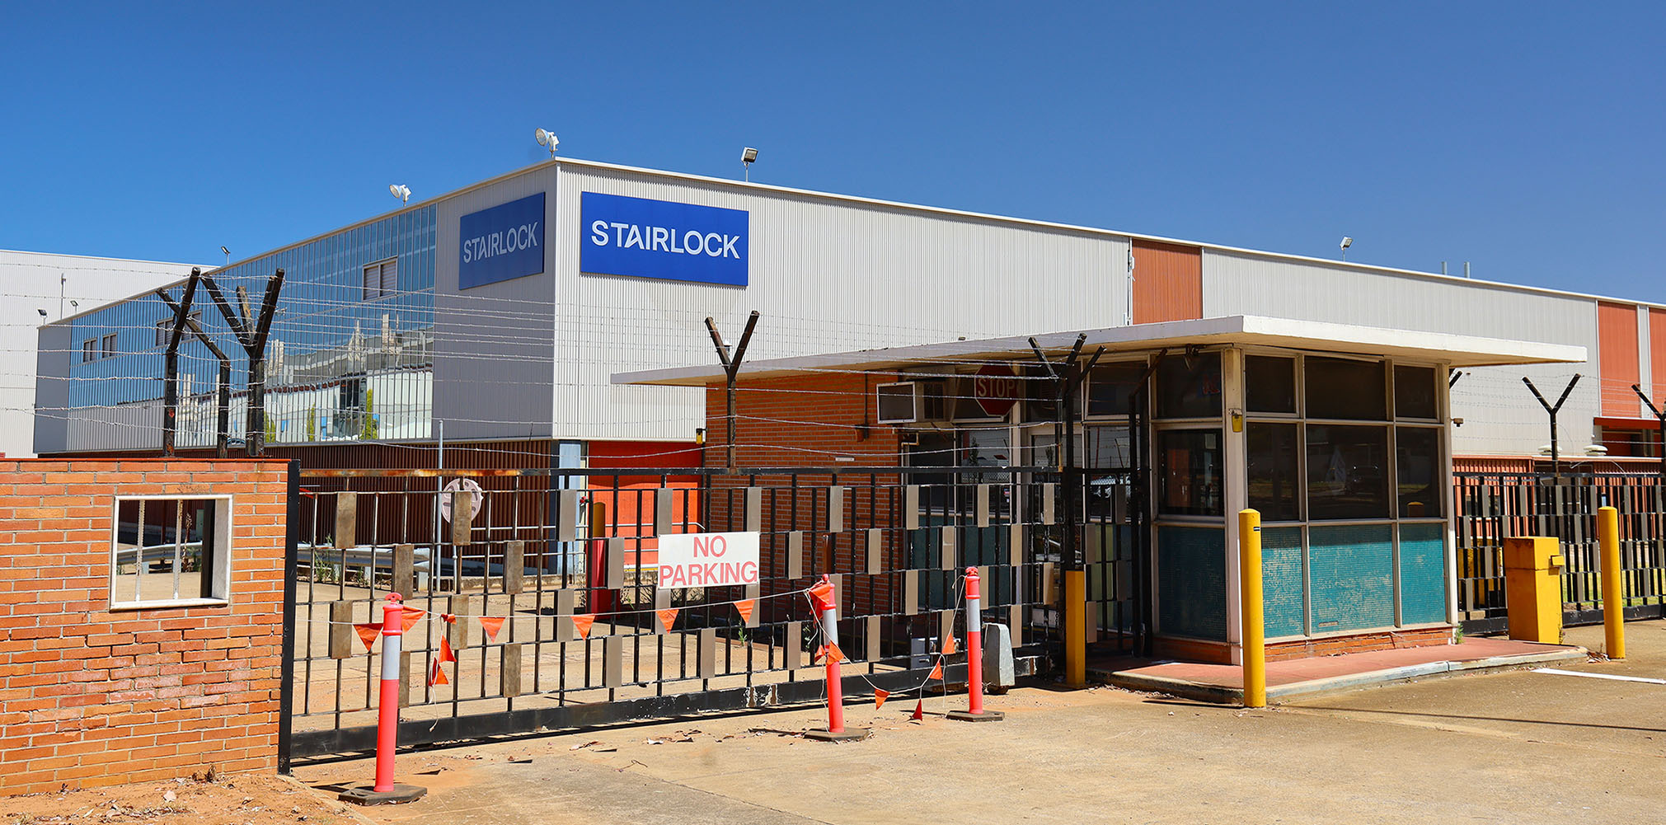
Discussion
In addition, at a conceptual level the preferences of workers had a communality that spoke to the cumulative impact of their individual actions.
Although individual workers spoke about their choices as individuals and did not give evidence of an awareness of the collective importance of their actions, it is clear that there was such an impact, as reflected in nationally and regionally significant skills shortages.
Ehat was said by respondents– their personal narratives of transition – reflected an agency that is achieved by declining opportunities that did not meet their expectations. To turn down an opportunity for retraining is impactful, as is the inability to make a decision that would reposition them in the labour market

Slide 19
Conclusion
There is clear evidence that workers seek a sense of control – or agency – as they navigate the world of job search and reemployment. They choose jobs closer to home in order to enhance their lives, and through that preference fundamentally shaped the geographic distribution of skills in the labour force.
Workers believed in their ability to determine their own employment future, even if that was only able to be expressed by rejecting job offers or reskilling opportunities.
Second, it is evident from the analysis of how workers described their post auto industry experience that they did not consider the cumulative impact of their decision making, which in aggregate has made the path to a fundamental transformation of these economies more challenging.

Slide 20
Conclusion
From the perspective of a positive regional transformation, former auto employees made sub-optimal decisions, and did so because of the institutional context within which decisions were made.
These workers became actors giving life to a form of agency, but did so without an intention of bringing about change – they were agents of transformation without a collective purpose or objective.
This observation challenges current conceptualisations of agency within the literature and calls for a more nuanced understanding of the relationship between agency and those factors labelled as ‘pre-existing’ conditions in the established EEG literature.
The literature tends to ascribe causality to structural process because of the absence of insight into the micro-decisions of individuals, households or other key populations. Qualitative analysis of in-depth interviews, however, begins to overcome this limitation by providing insights into these all-important life decisions. They make possible new fields of theorisation and enquiry of enduring value to studies of regions and their growth.

Slide 21
Conclusion
And perhaps we are rediscovering the insights of the past:
… much of social life is a result of the unintended consequences of the cumulative actions of large numbers of past and present actors…Individuals may be unaware of all the causes of their behaviour, and intentions may form only a portion of the explanation of action. However, we suggest that macroscale social structures should be precisely defined, that they do not have autonomy or an existence that is not ultimately reducible to cumulative human actions and interactions, and that the processes linking structure or context and individual or social action need to be carefully specified (Duncan & Ley 1982 p 32).

Slide 22
Conclusion
Finally, it is worth reflecting on the broader epistemology and methodological positioning of agency-related research within the broad field of regional studies.
With some notable exceptions (Blažek et al. 2021; Bellandi et al. 2021), much of the literature has focussed on case studies of success – places where economic transformation has emerged, through what are now well-understood processes.
Researchers may learn more about the fundamental processes underpinning the transition of economies and the forging of new industry pathways by focussing on those places that have not moved to a more positive trajectory.
We have more to learn from failure and we need to build failure into our theoretical models.

